Slide 1
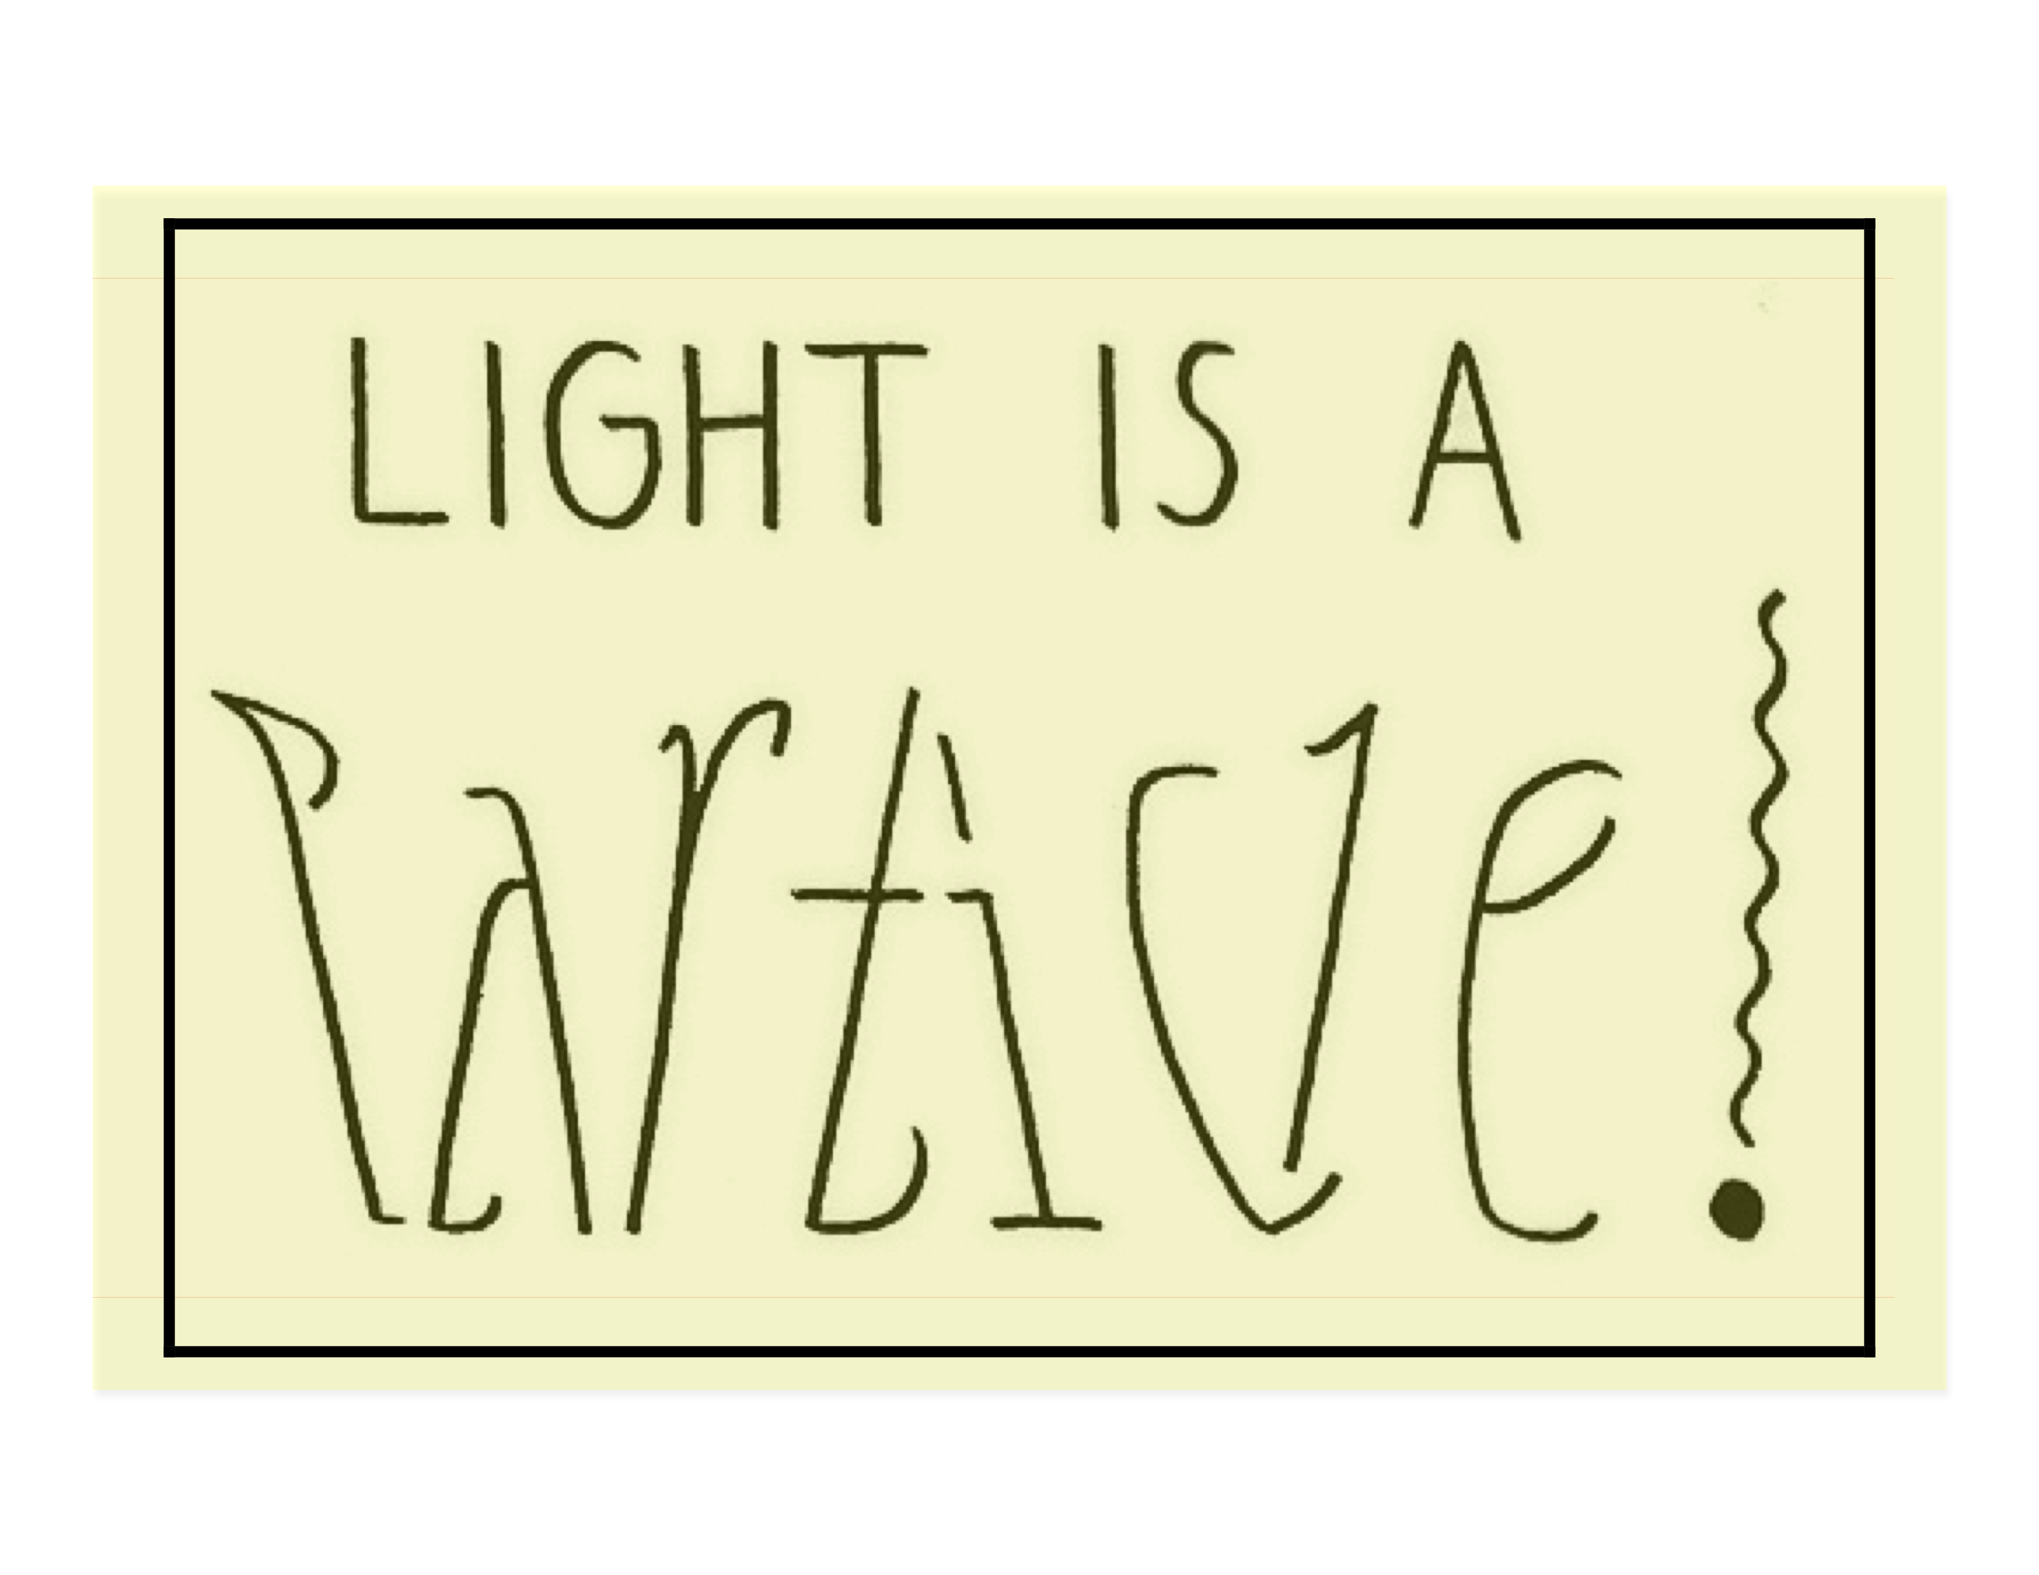

Slide 2
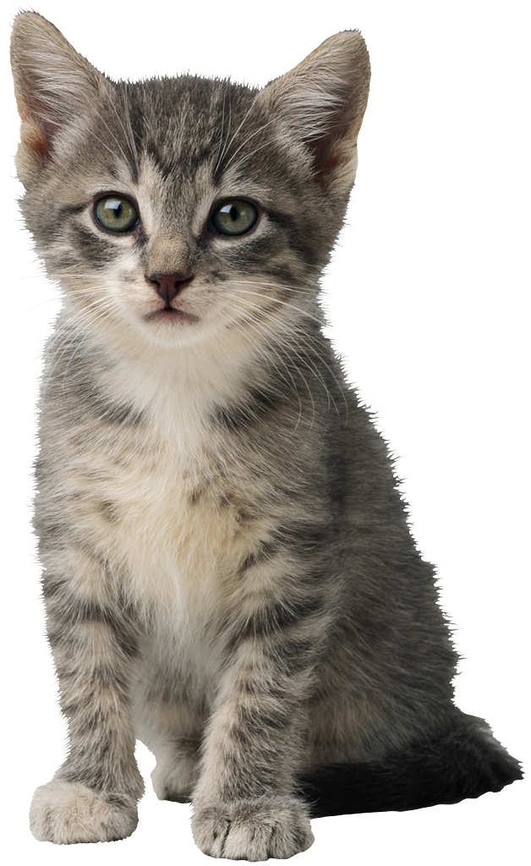

See-Through Bucket
Periscope
Pseudoscope
Can you do it with 3 mirrors? What will be different about the image?

Slide 3
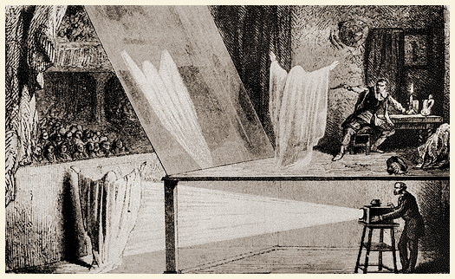
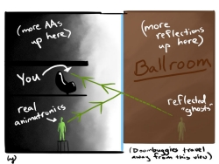
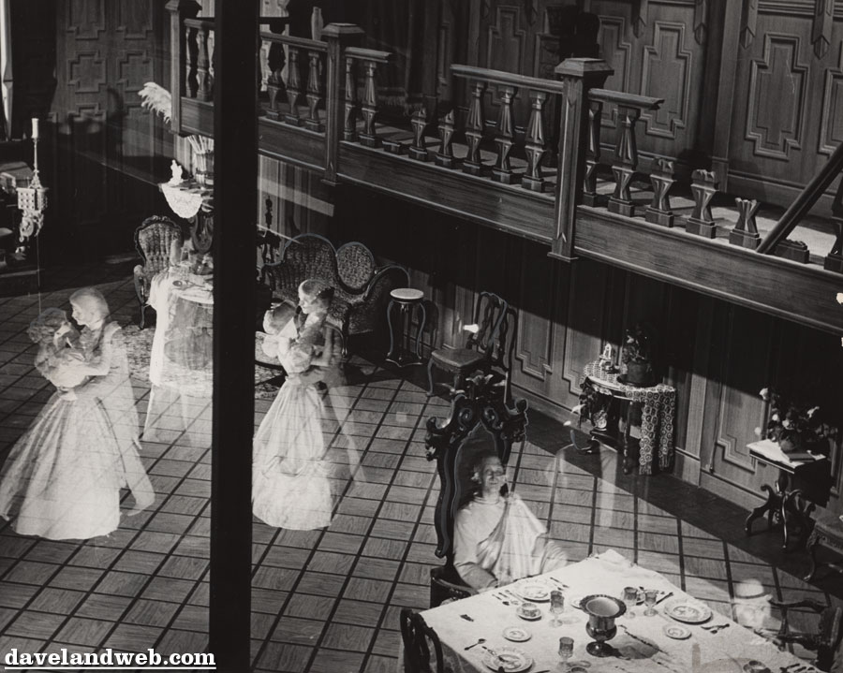
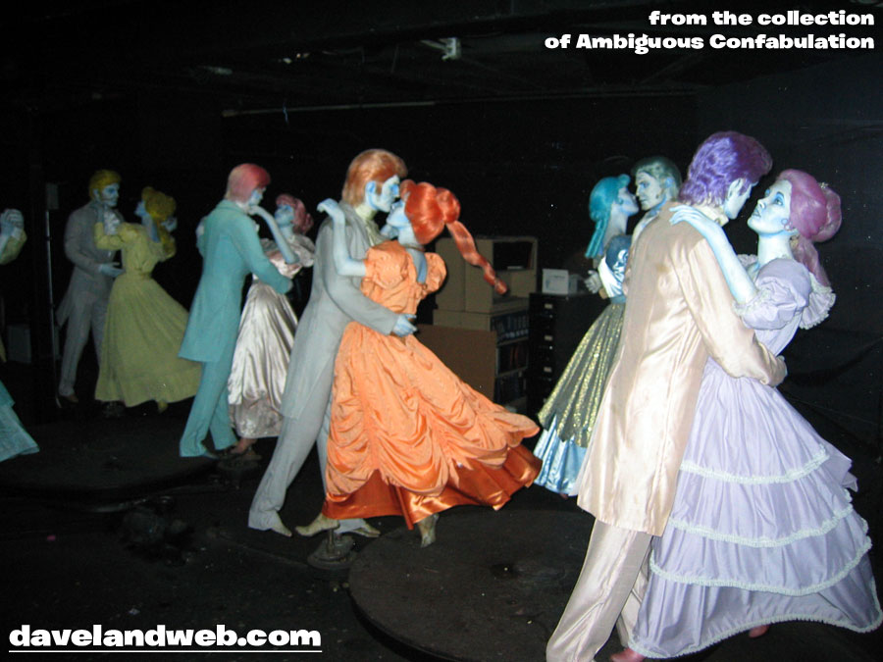
Pepper’s Ghost

Slide 4
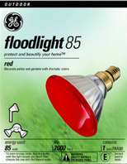
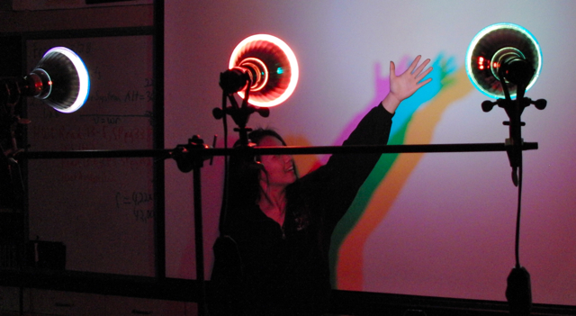
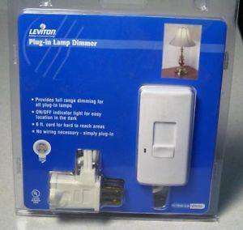
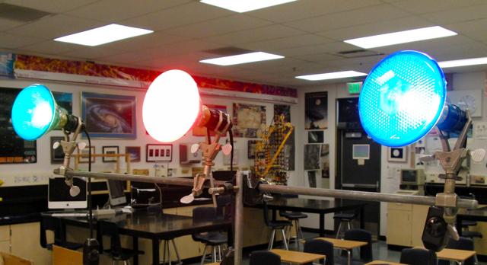
Colored Shadows
85 Watt Flood Light
Plug In Lamp Dimmer

Slide 5
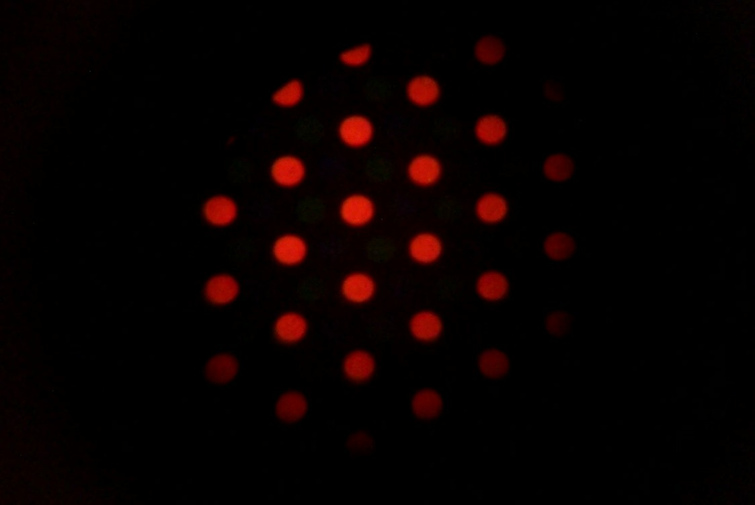
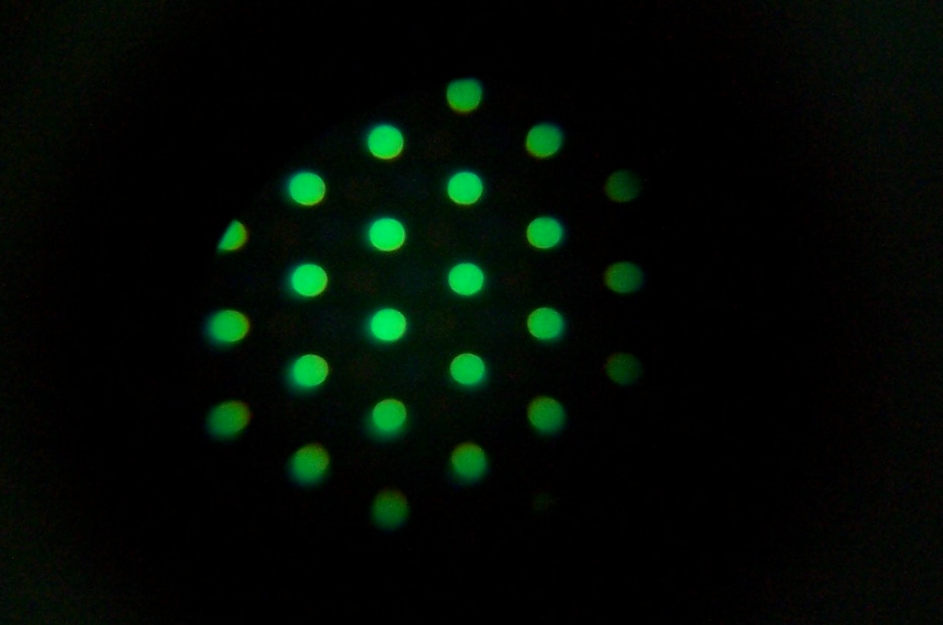
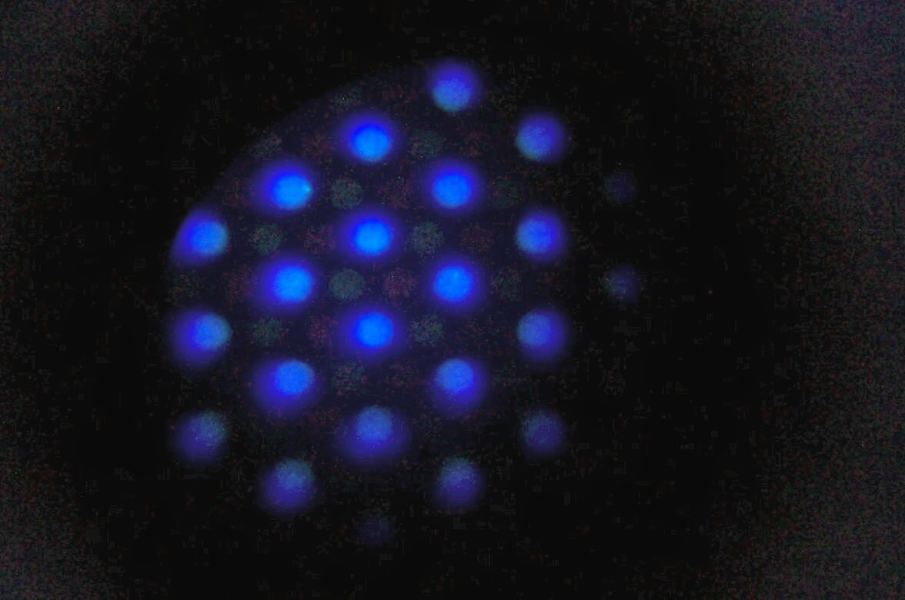
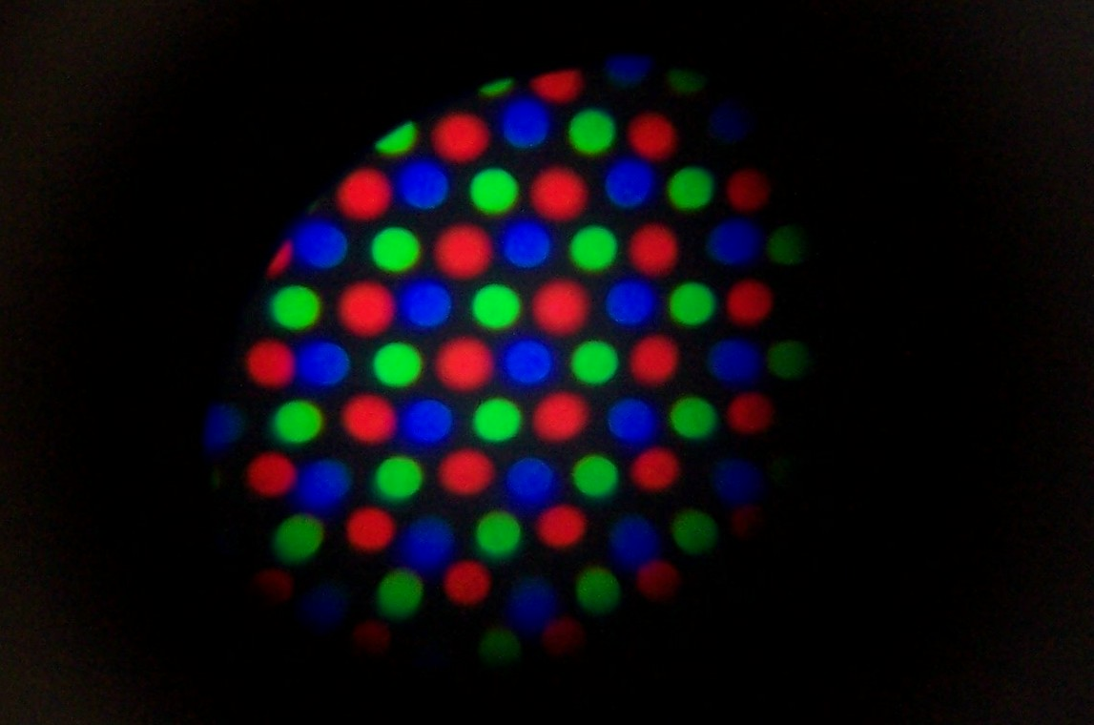
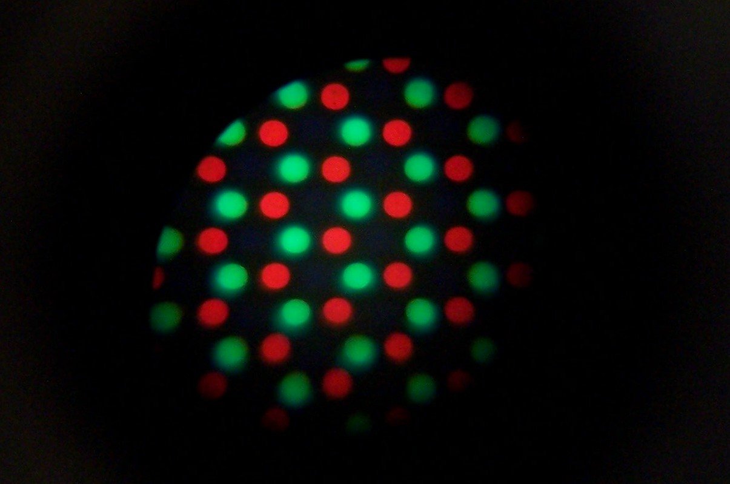
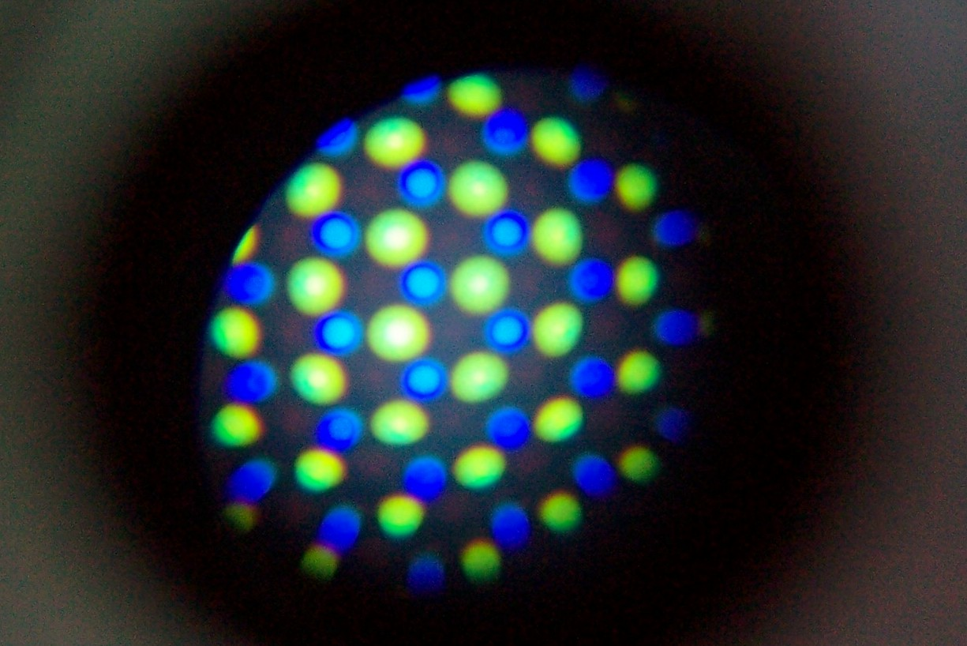
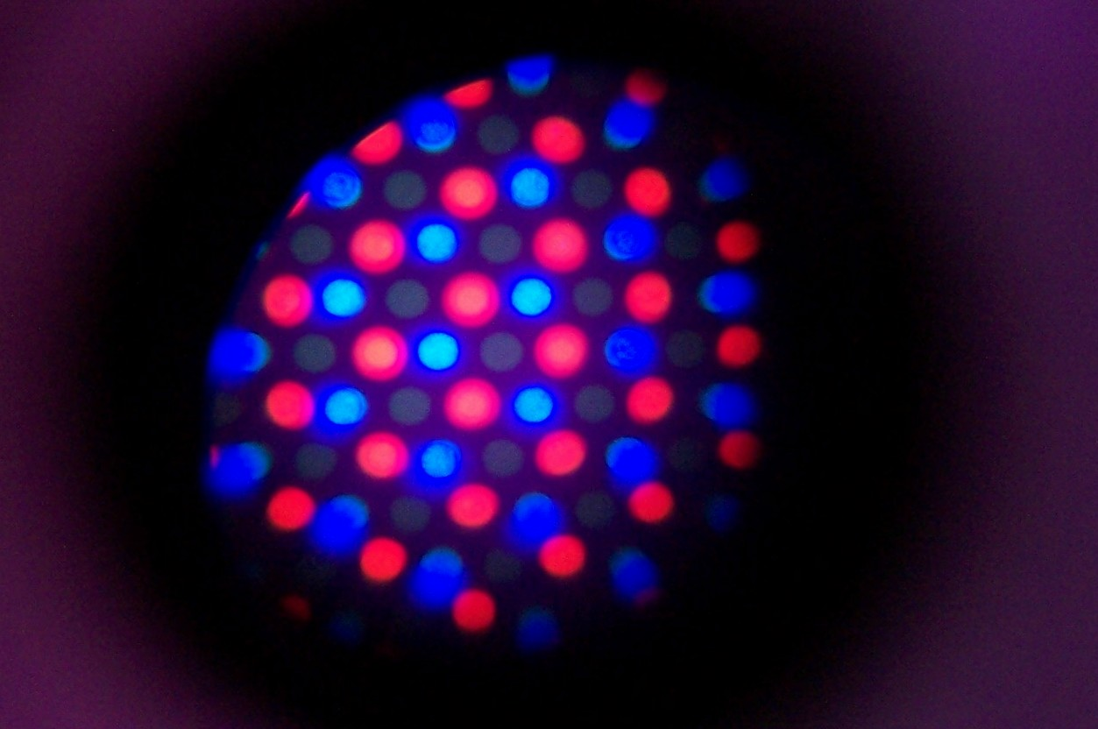
Computer Moniter Pixels
Red
Green
Blue
White
Yellow
Cyan
Magenta
Taken with Edmund Scientific 50X Pocket Microscope $29.95 at http://scientificsonline.com/product.asp_Q_pn_E_3031853

Slide 6
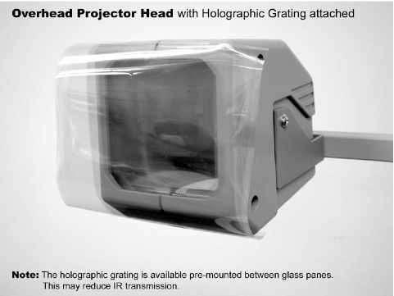
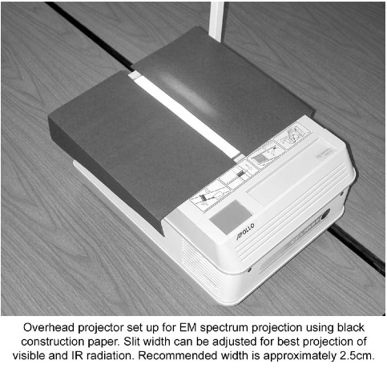
Overhead Projector Spectroscope

Slide 7
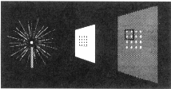
Perfboard Inverse
Square Law Activity
http://www.exploratorium.edu/snacks/inverse_square_law/index.html

Slide 8
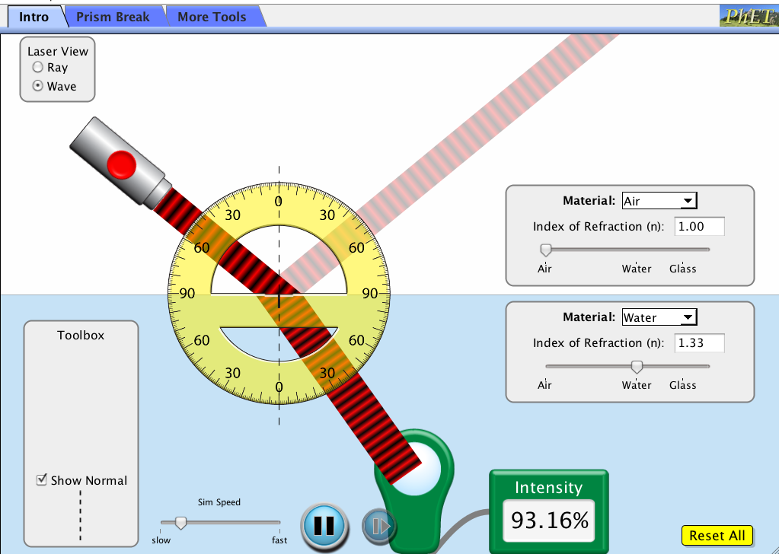
PhET Bending Light Sim
Run Sim
https://phet.colorado.edu/en/simulation/bending-light

Slide 9
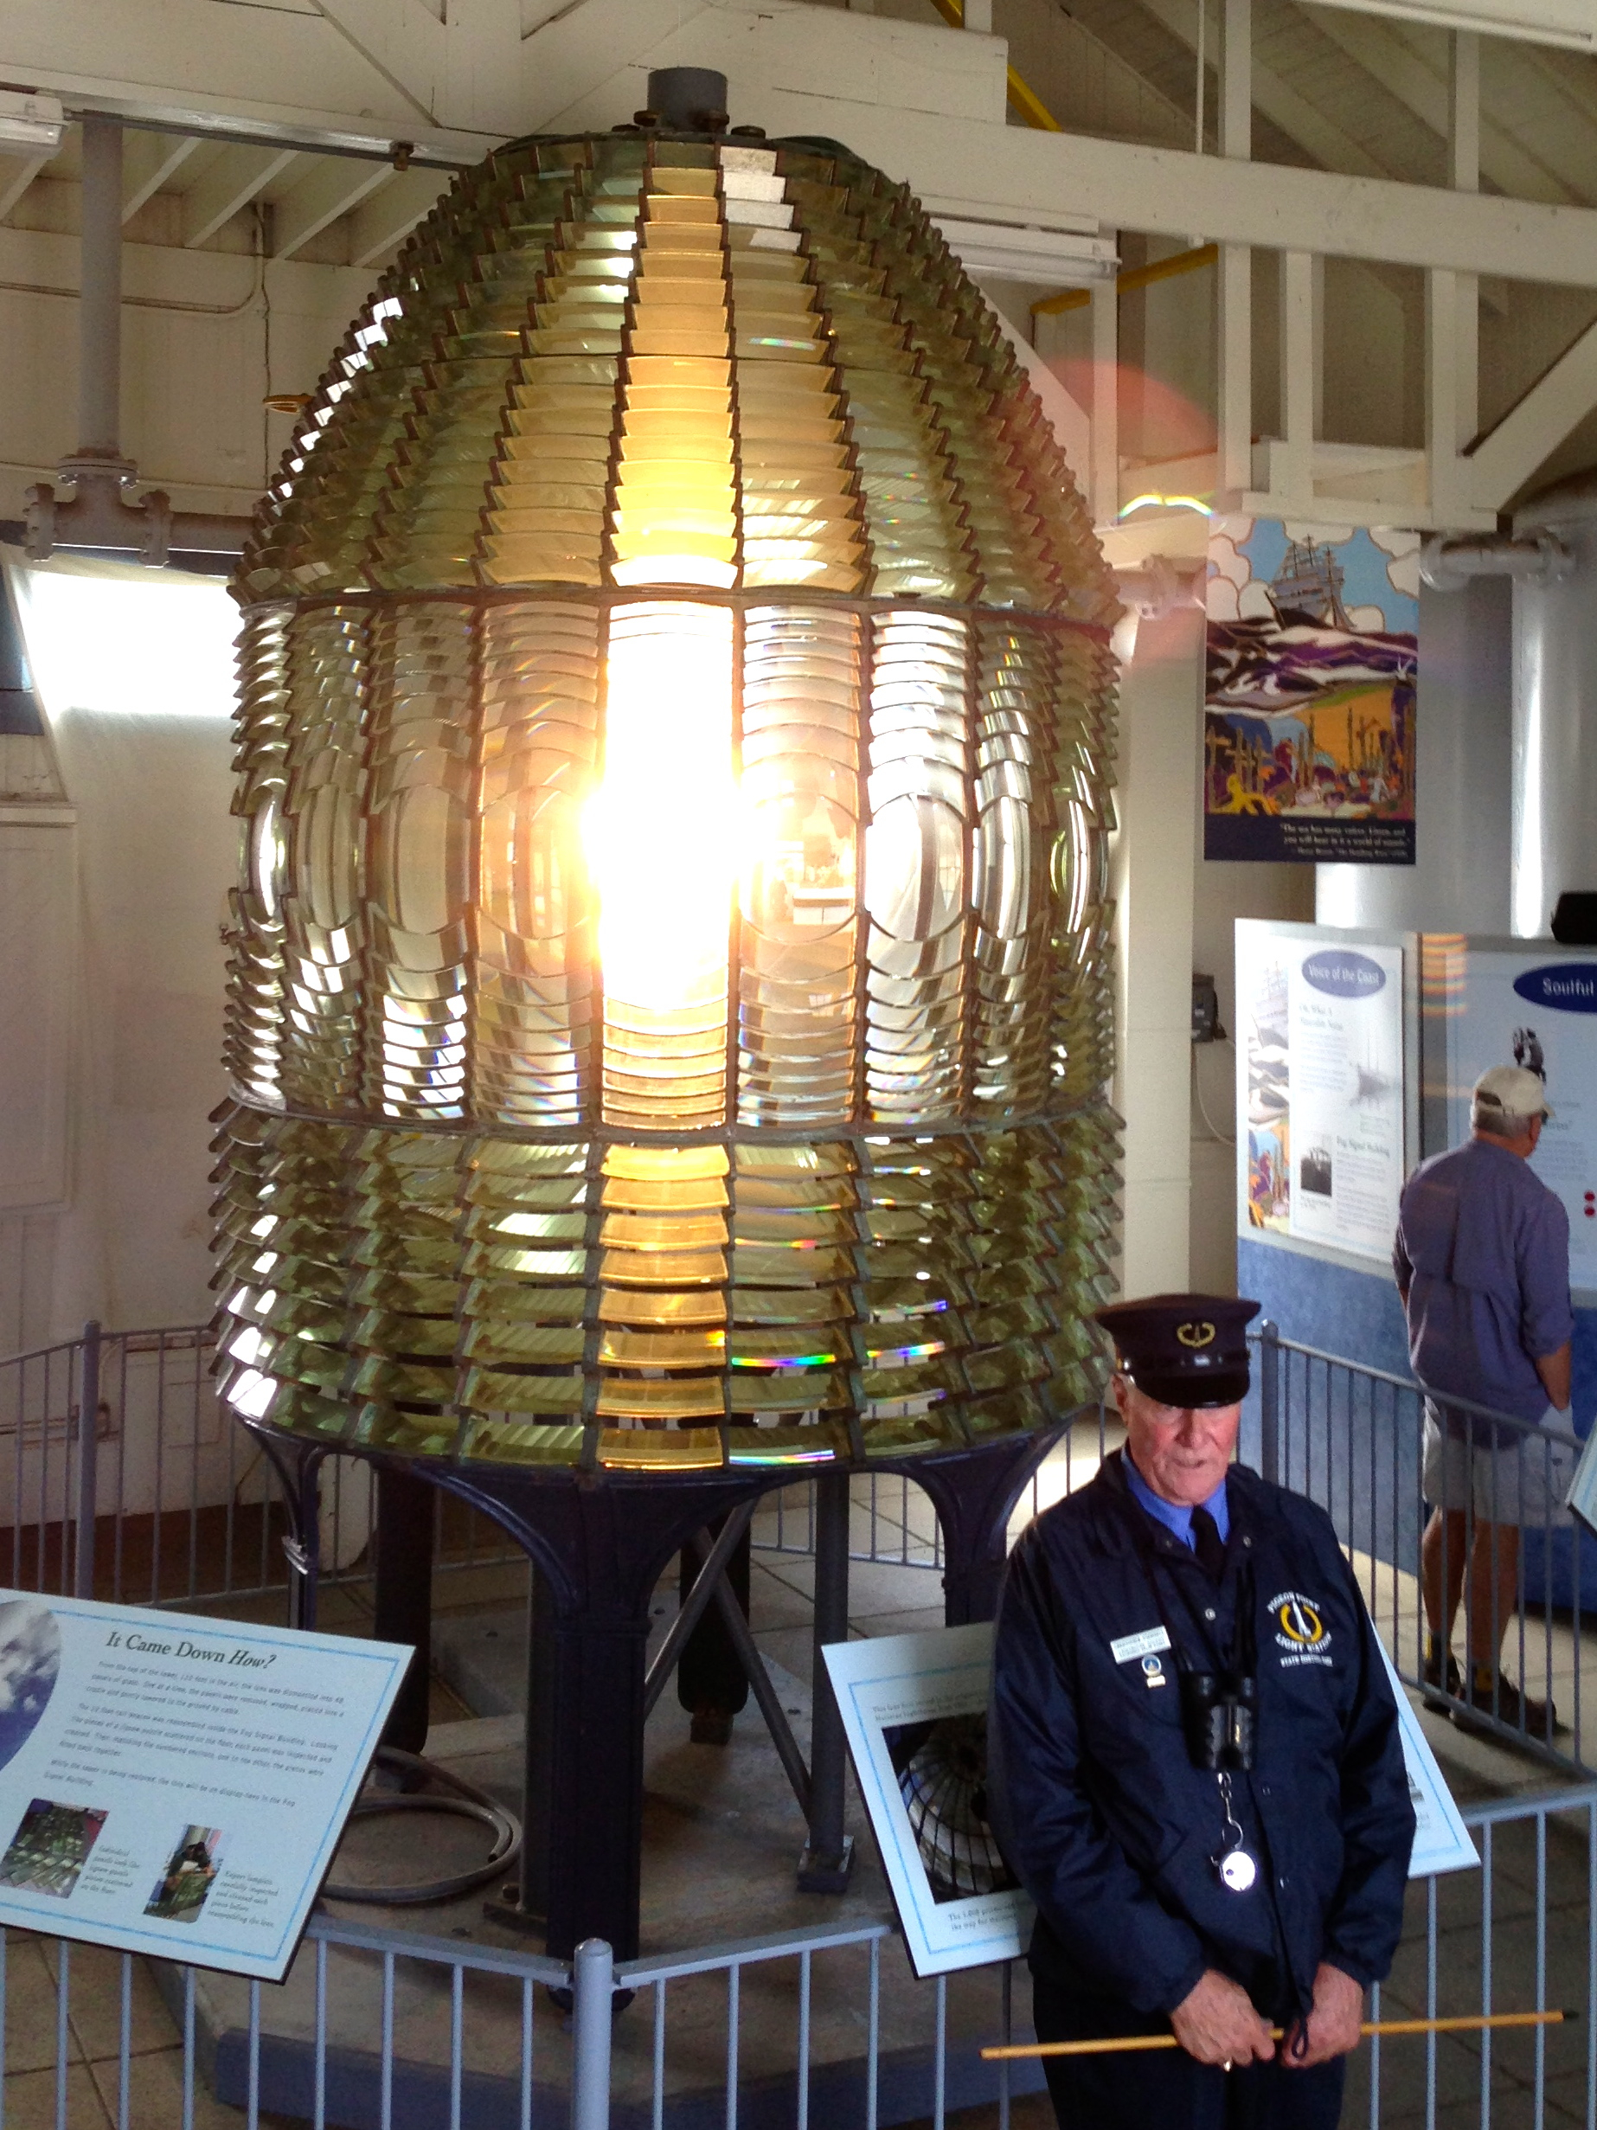
Pigeon Point Fresnel Lens

Slide 10
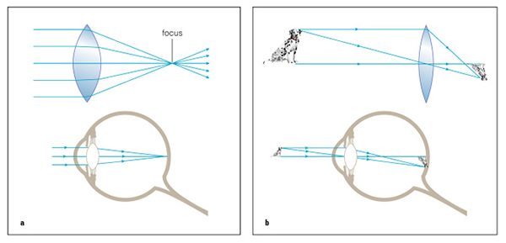
Convex Lens Image and the Eye
How Can We demonstrate the Image on the Retina is Upside Down?
Shine a Flashlight into Your Mouth!

Slide 11
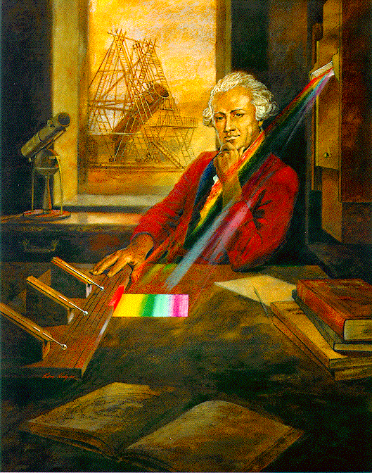
William Herschel
German Immigrant to England
Discovered Uranus in 1781
Catalogued Night Sky with Sister Caroline
Discovered IR in 1800
NASA/JPL-Caltech

Slide 12
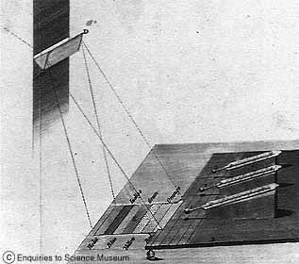
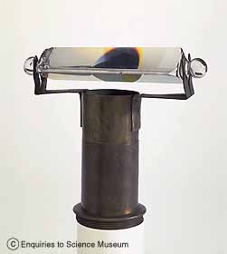
Herschel’s IR Experiment
Investigated heat of colors in spectrum
Temperature increased from violet to red
Placed a thermometer beyond red, this measured greatest temperature increase
http://www.sciencemuseum.org.uk/on-line/treasure/objects/1876-565.asp

Slide 13
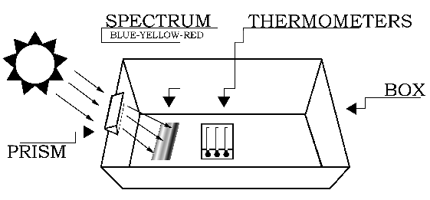
Student Herschel Experiment
NASA/JPL-Caltech
Materials: Copy Paper Box, Smaller Box, White Paper, Tape, Equilateral Glass Prism, Black Paint, Timer, 3 Thermometers, Sunlight!
Time Required: ~ 30 minutes

Slide 14
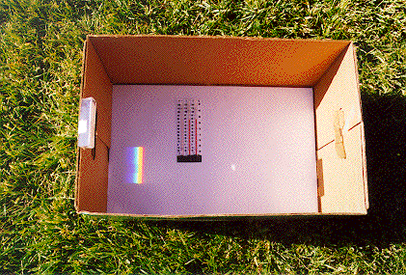
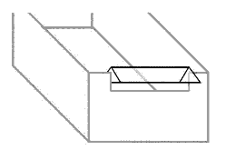
Equipment Setup
NASA/JPL-Caltech
NASA/JPL-Caltech
Paint Thermometer Bulbs Black
Trim and Tape Thermometers Close Together
Cut Opening for Prism and Mount it
Tape White Sheet of Paper to Bottom of box

Slide 15
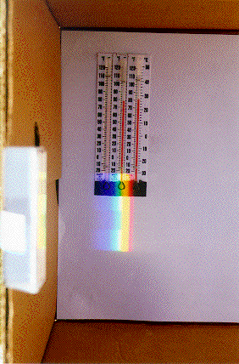
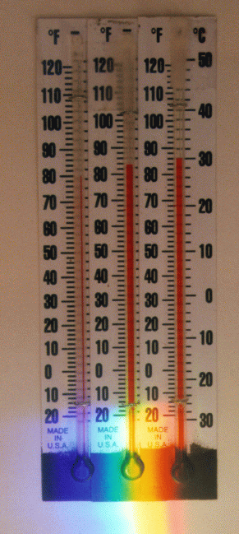
Procedure Outline
NASA/JPL-Caltech
NASA/JPL-Caltech
NASA/JPL-Caltech
Position Box and Prism so Spectrum Shows
Record Shade Temperature
Place Thermometers, 1 each in Blue, Yellow, and IR
Record Temperatures at 1 minute intervals for 5 minutes

Slide 16
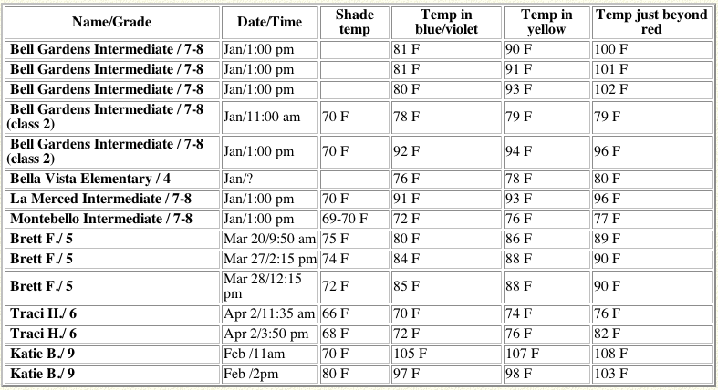
Typical Results
NASA/JPL-Caltech

Slide 17
Herschel Experiment Resources
http://coolcosmos.ipac.caltech.edu/cosmic_classroom/classroom_activities/herschel_experiment.html for detailed activity
www.sciencekit.com for prism (catalog # 3038400 $8.95) and thermometers (catalog # 6638910 $13.25 for 10-Pack)

Slide 18
Solar Cell IR Detector Resources
www.radioshack.com for Mini Audio Amplifier (Catalog # 2771008 $14.99), Solar Cell (Catalog # 277-1201 $13.99),
6’ Cable (Catalog # 42-2420 $3.29)
http://www.sofia.usra.edu/Edu/materials/activeAstronomy/activeAstronomy.html for detailed activity information

Slide 19
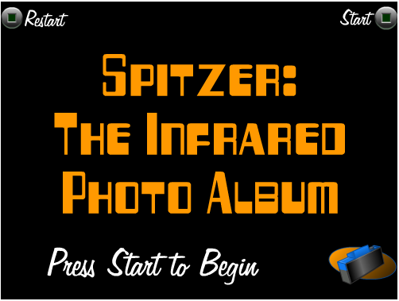
IR Photo Album Resources
http://spaceplace.jpl.nasa.gov/en/kids/sirtf1/sirtf_action.shtml for activity

Slide 20
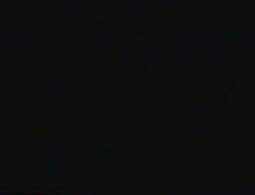
Cool Cosmos Website
http://coolcosmos.ipac.caltech.edu/videos/more_than_your/index.html

Slide 21
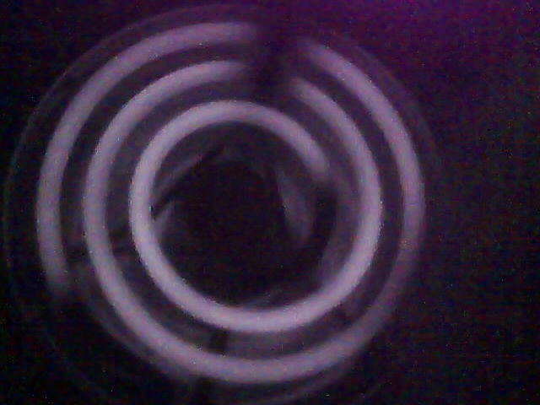
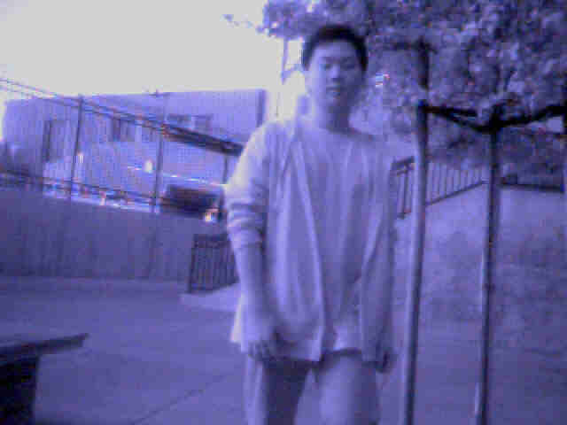
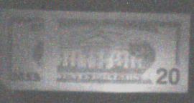
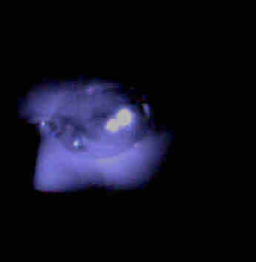
Near IR Digital Camera
Webcams, Digital Cameras, or Camcorders
Remove IR Blocking Filter from CCD
Install IR only pass filter (Wratten 87c, exposed color negative, or floppy disk)
Reassemble and view the world in Near IR

Slide 22
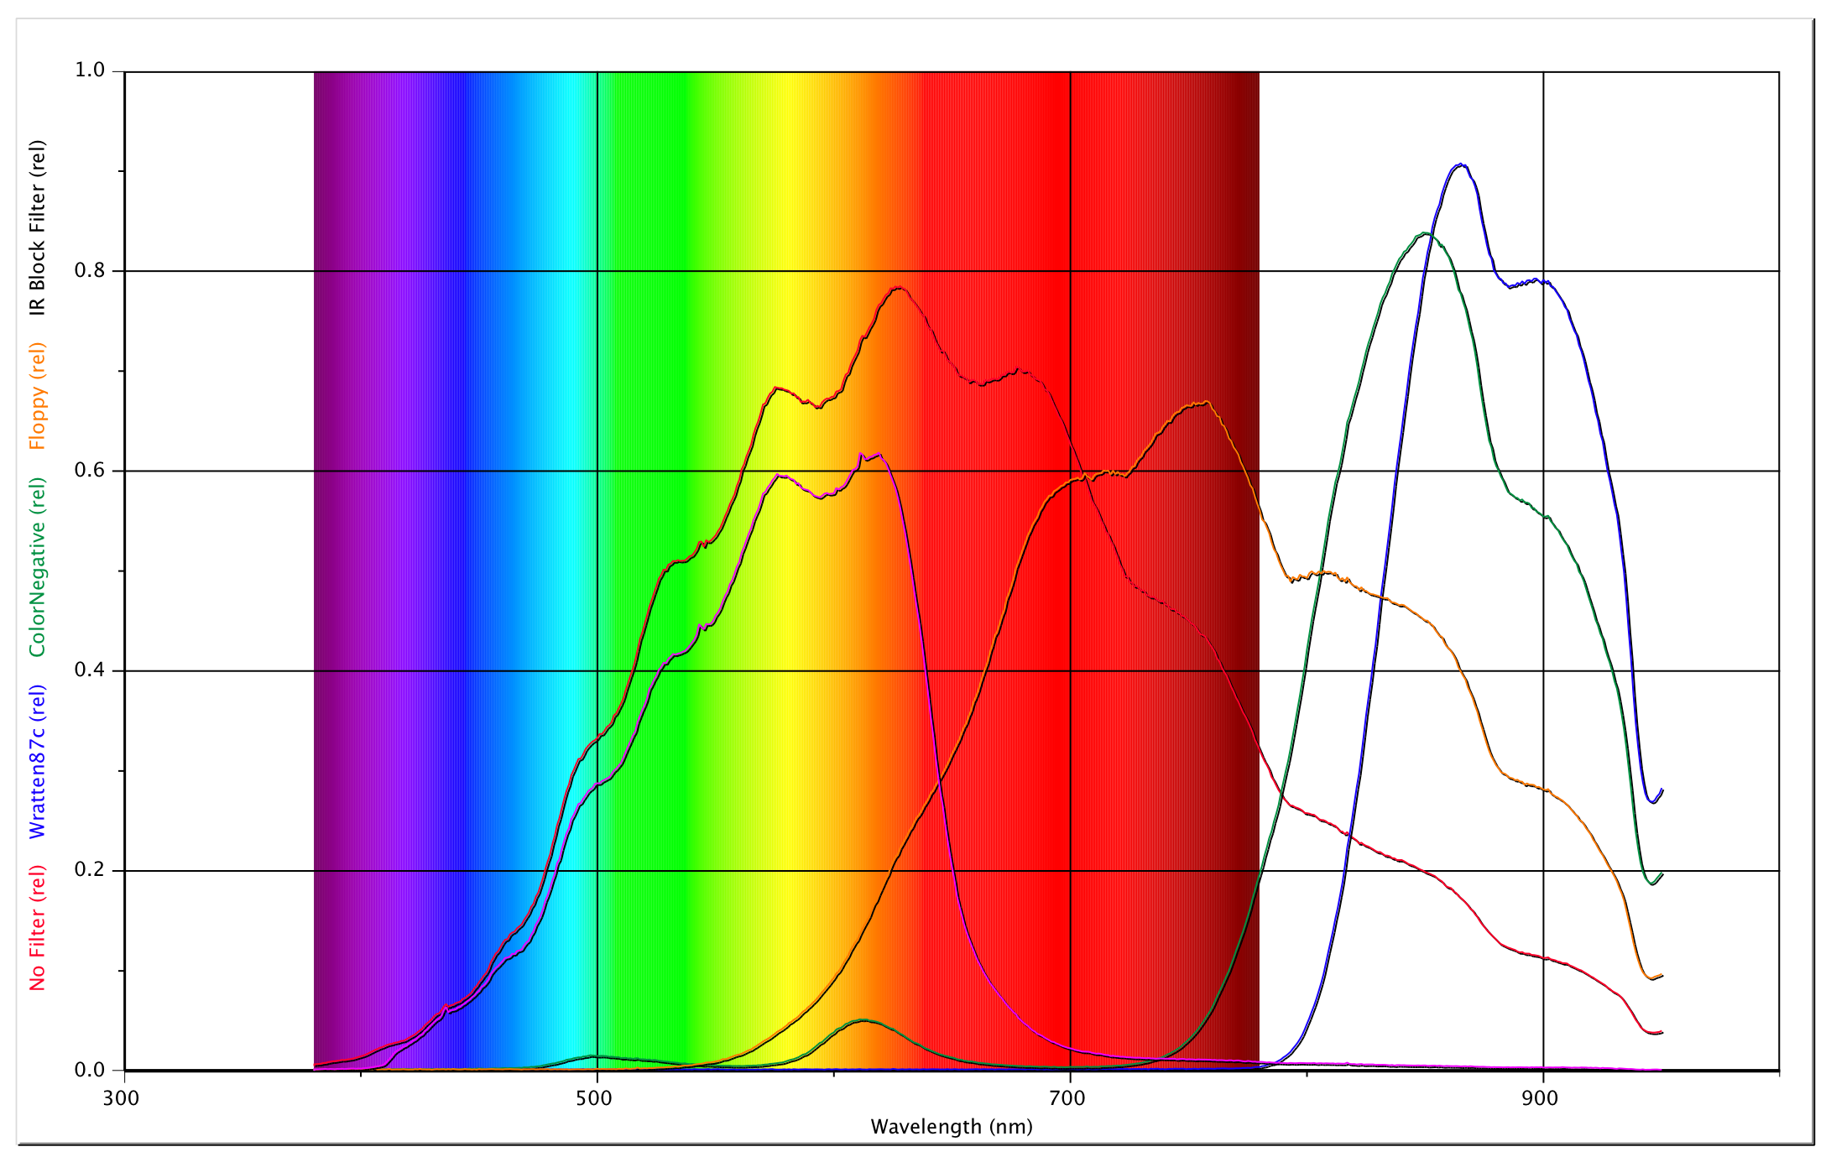
IR Filter Spectral Characteristics

Slide 23
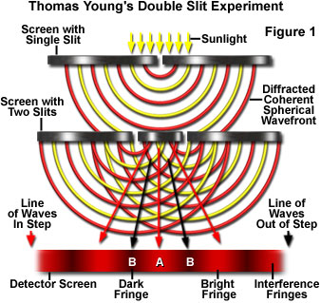
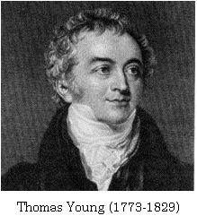
Double Slit Diffraction
A wave passing through two slits diffracts. The two diffracted waves then interfere constructively and destructively. This produces a pattern of light and dark spots

Slide 24
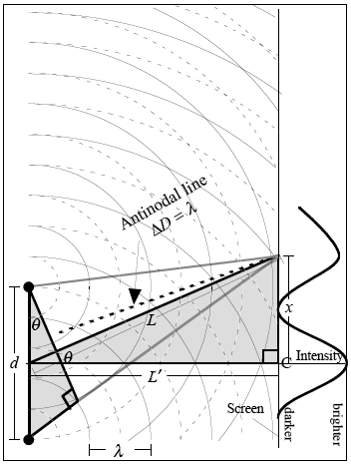
Assume rays are parallel
Double Slit Diffraction
For small angles,
sin(θ) = tan(θ)
For “nth” bright fringe:
For “nth” dark fringe:

Slide 25
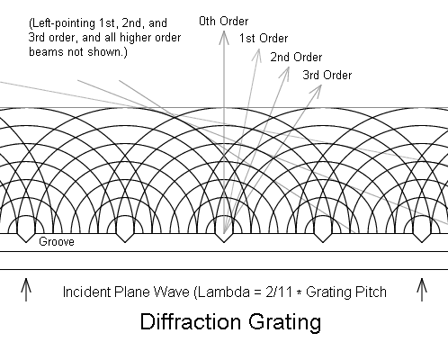
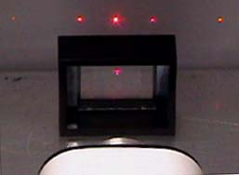
Multiple Slit Diffraction
A grating has many slits. It produces a pattern similar to two slit diffraction except the pattern of light is more intense and better defined

Slide 26
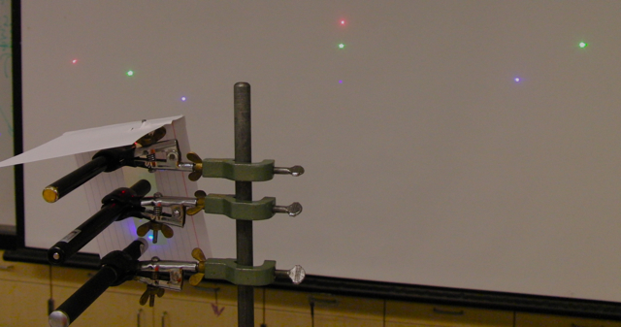
Laser Diffraction Tower

Slide 27
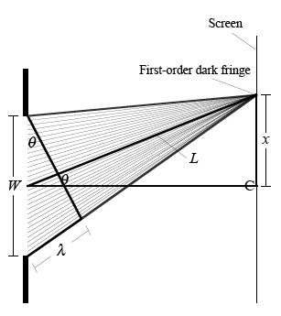
Assume rays are parallel
Single Slit Diffraction
For small angles,
sin(θ) = tan(θ)
For “nth” dark fringe:
For “nth” light fringe:

Slide 28
Photoelectric Effect and Color
Remove red LED and connect to a voltmeter (long lead +)
Shine blue LED into the red and read voltage
Try reversing and other color combinations
Can you create a model to explain your observations?
Try to use blue shining into green to light up a red!
See “Light Emitting Diodes” page 6

Slide 29

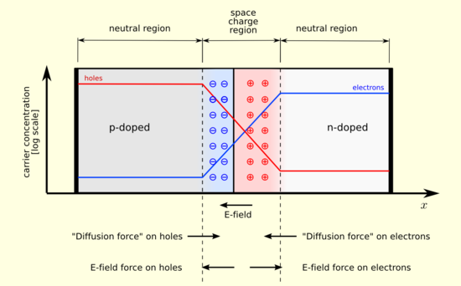
How an LED Works

Slide 30
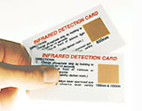
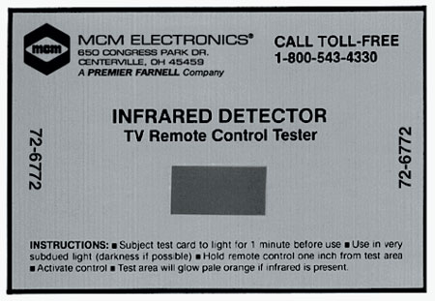
IR Detection Cards
2 Types of Materials can Produce Visible Light When Exposed to IR from a Remote Control
Anti-Stokes Material Absorbs 2 or More Photons for Every Visible Photon Emitted
Phosphorescent Material Must be Exposed to Visible Light First
See Activity from KSU Physics Education Group

Slide 31
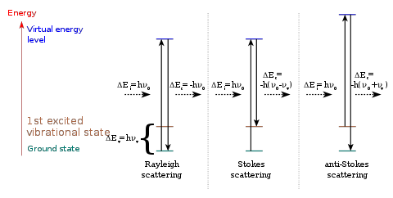

Anti-Stokes Model
Phosphorescent Model

Slide 32

Wien’s Law: T (K) = 2.9 x 10⁶/wavelength (nm)

Slide 33


Slide 34
200 kWHr in 1.7 s at $0.10/kWHr for 12 Hours
$ = (200 kWHr/1.7s)x
12Hr x 3600s/Hr x 0.1$/kWHr
= $508,235!

Slide 35

http://www.polleverywhere.com/

Slide 36

Hewitt Car Battery Circuit Demos
Circuits:
http://youtu.be/a6YyEeqFFDA
Circuits:
http://youtu.be/I2JLaWmeV30
Power:
http://youtu.be/S69d4kYtZ6M

Slide 37






Homopolar Motor
http://www.arborsci.com/CoolStuff/New_CoolStuff_Articles/C_33_1.aspx

Slide 38


http://physics.dickinson.edu/~wp_web/wp_homepage.html
The Mathematical Modeling Conceptual Evaluation (MMCE)
The Vector Evaluation Test (VET)
The Force-Motion Concept Evaluation (FMCE)
The Heat and Temperature Concept Evaluation (HCTE)
The Electric Circuits Concept Evaluation (ECCE)
The Maryland Physics Expectations Survey (MPEX)
User Name: WPInstructor
Password: GimmeStuff

Slide 39


Eddy Current Separator

