Slide 1
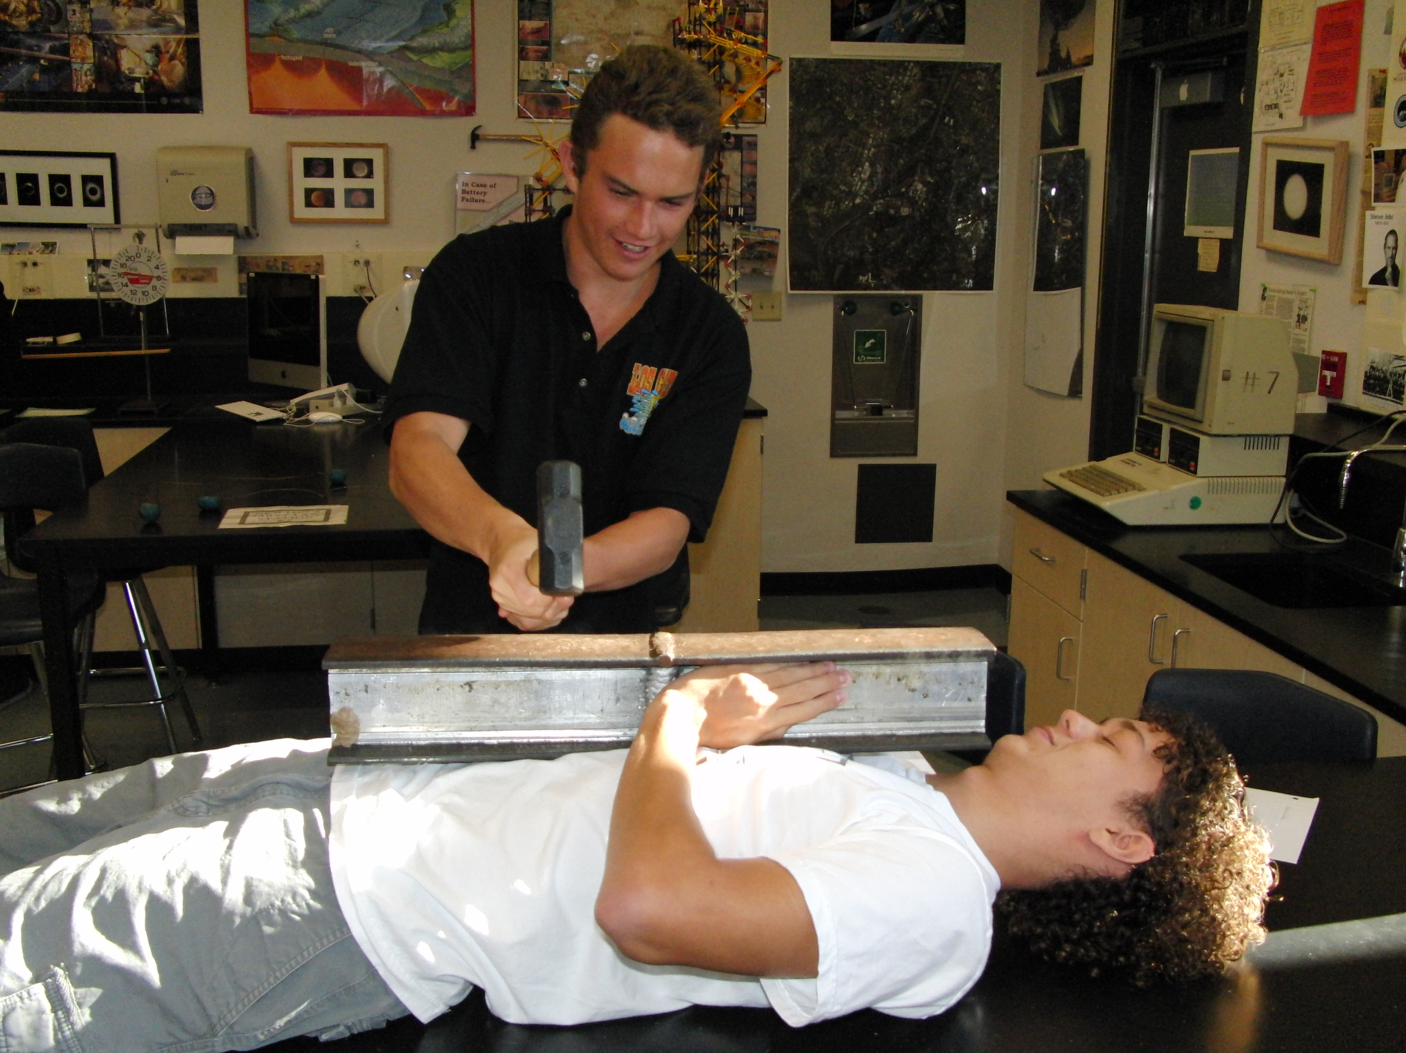
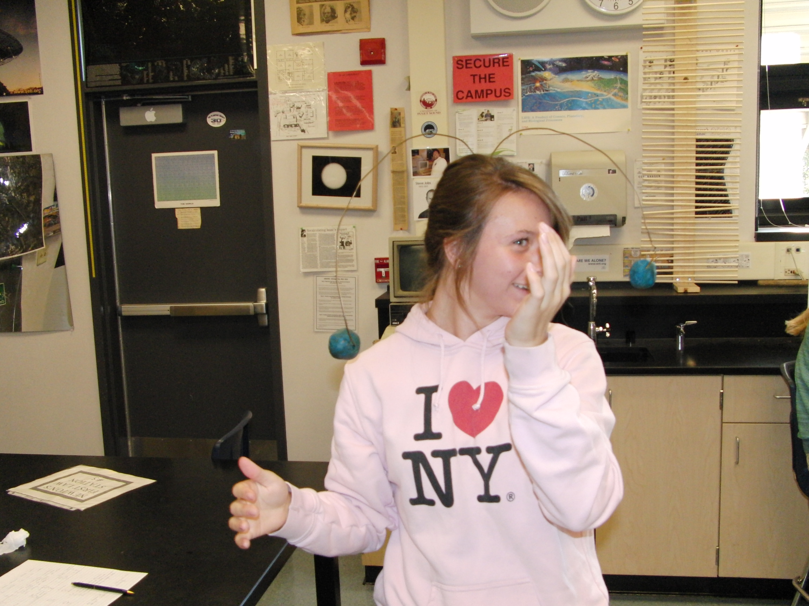
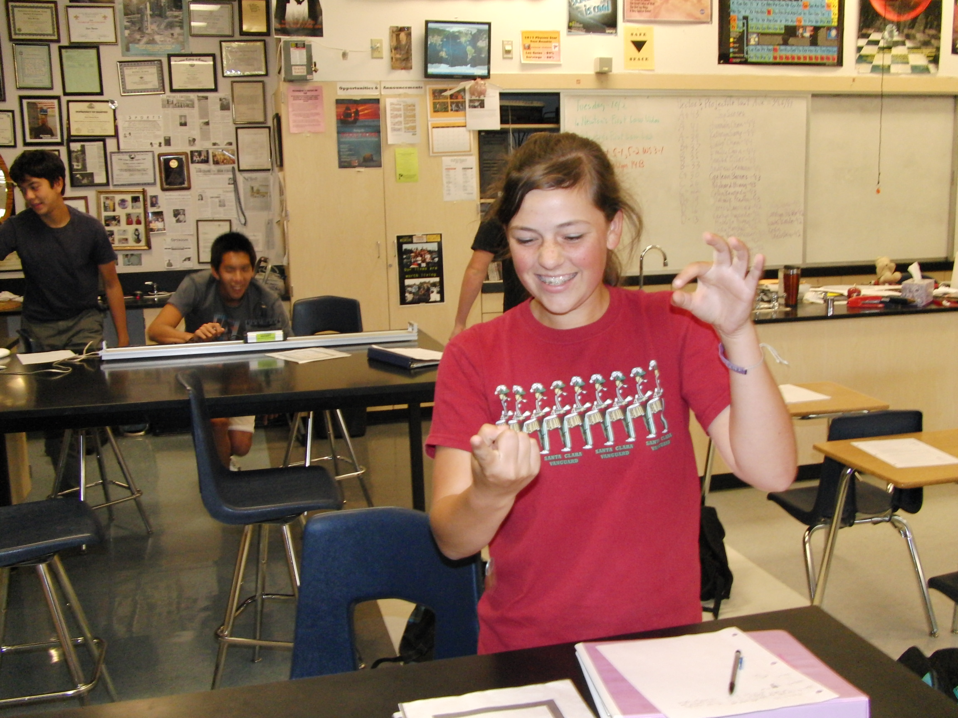
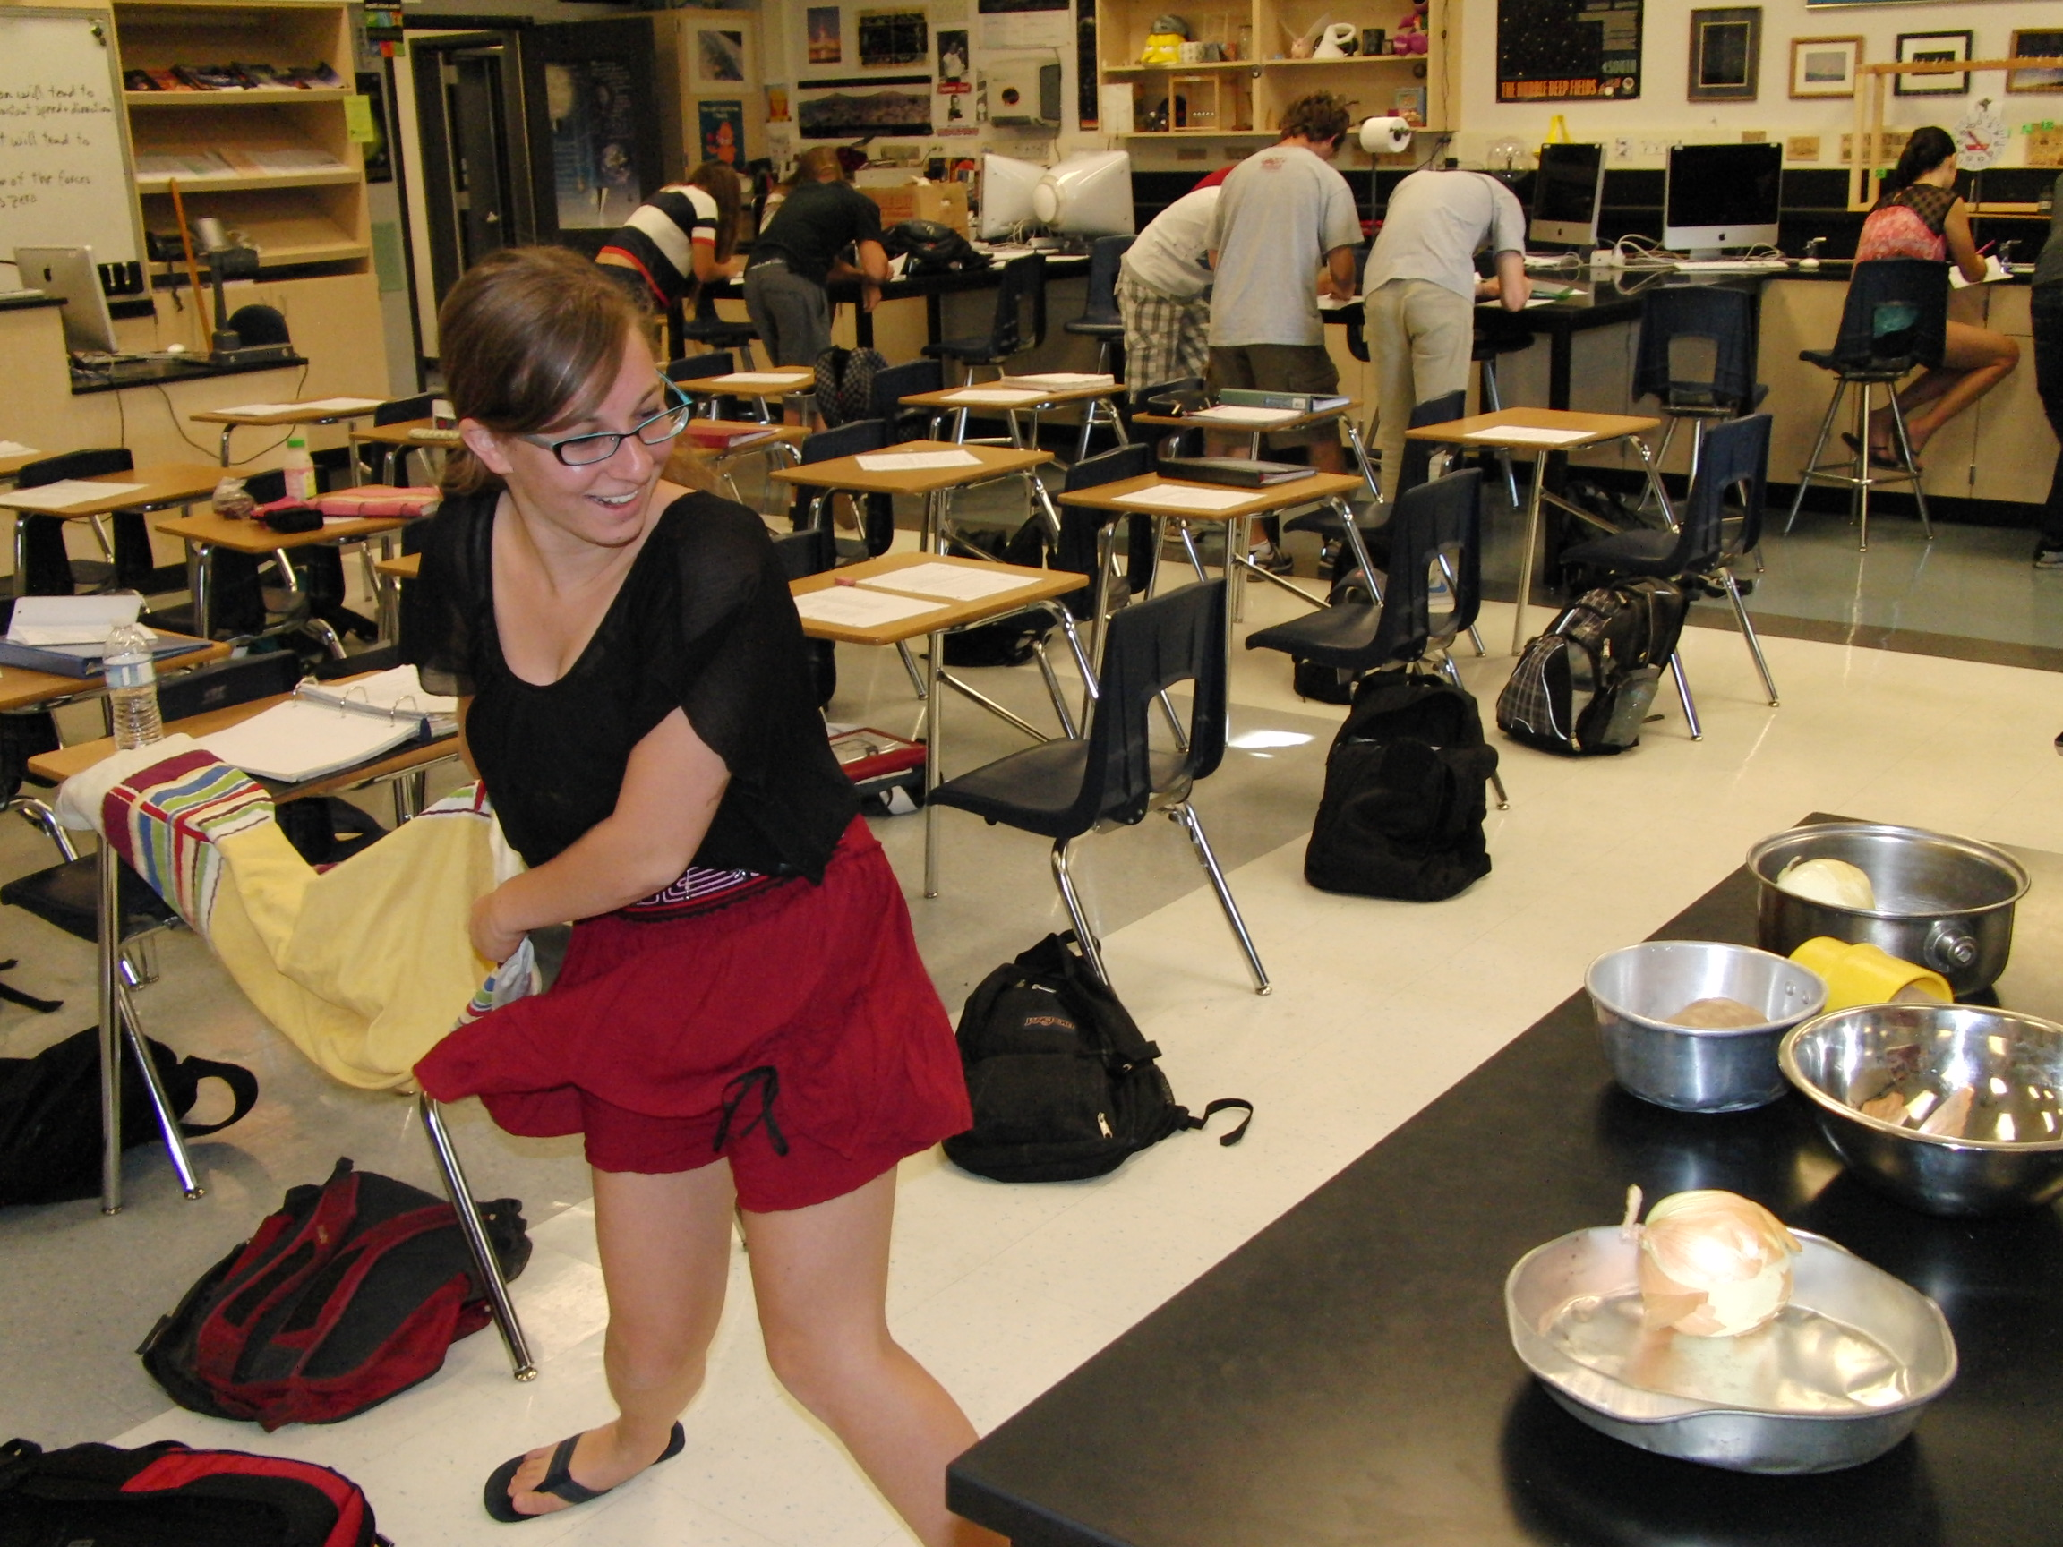
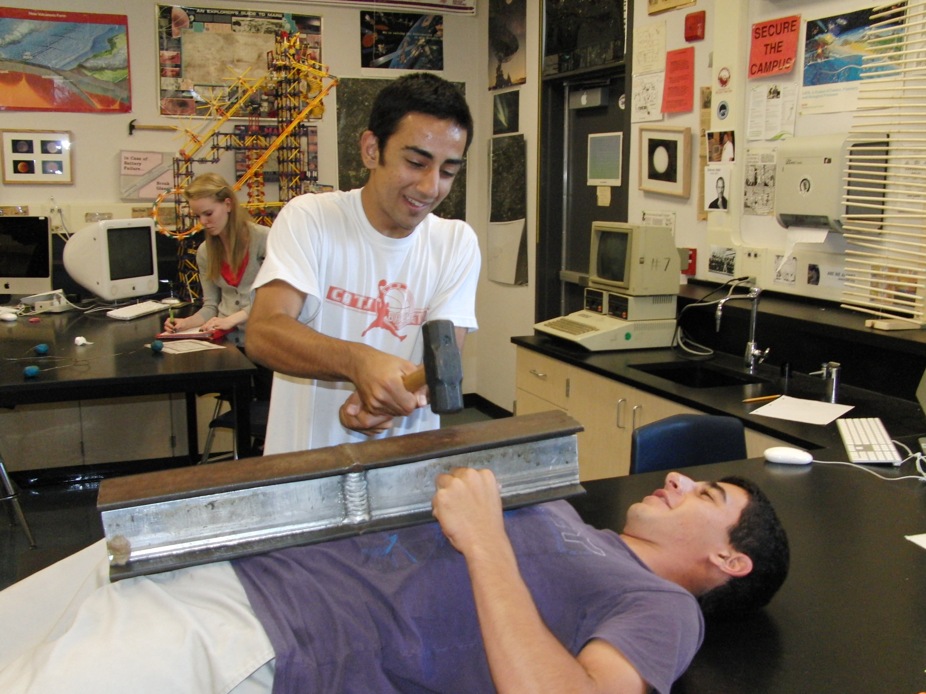
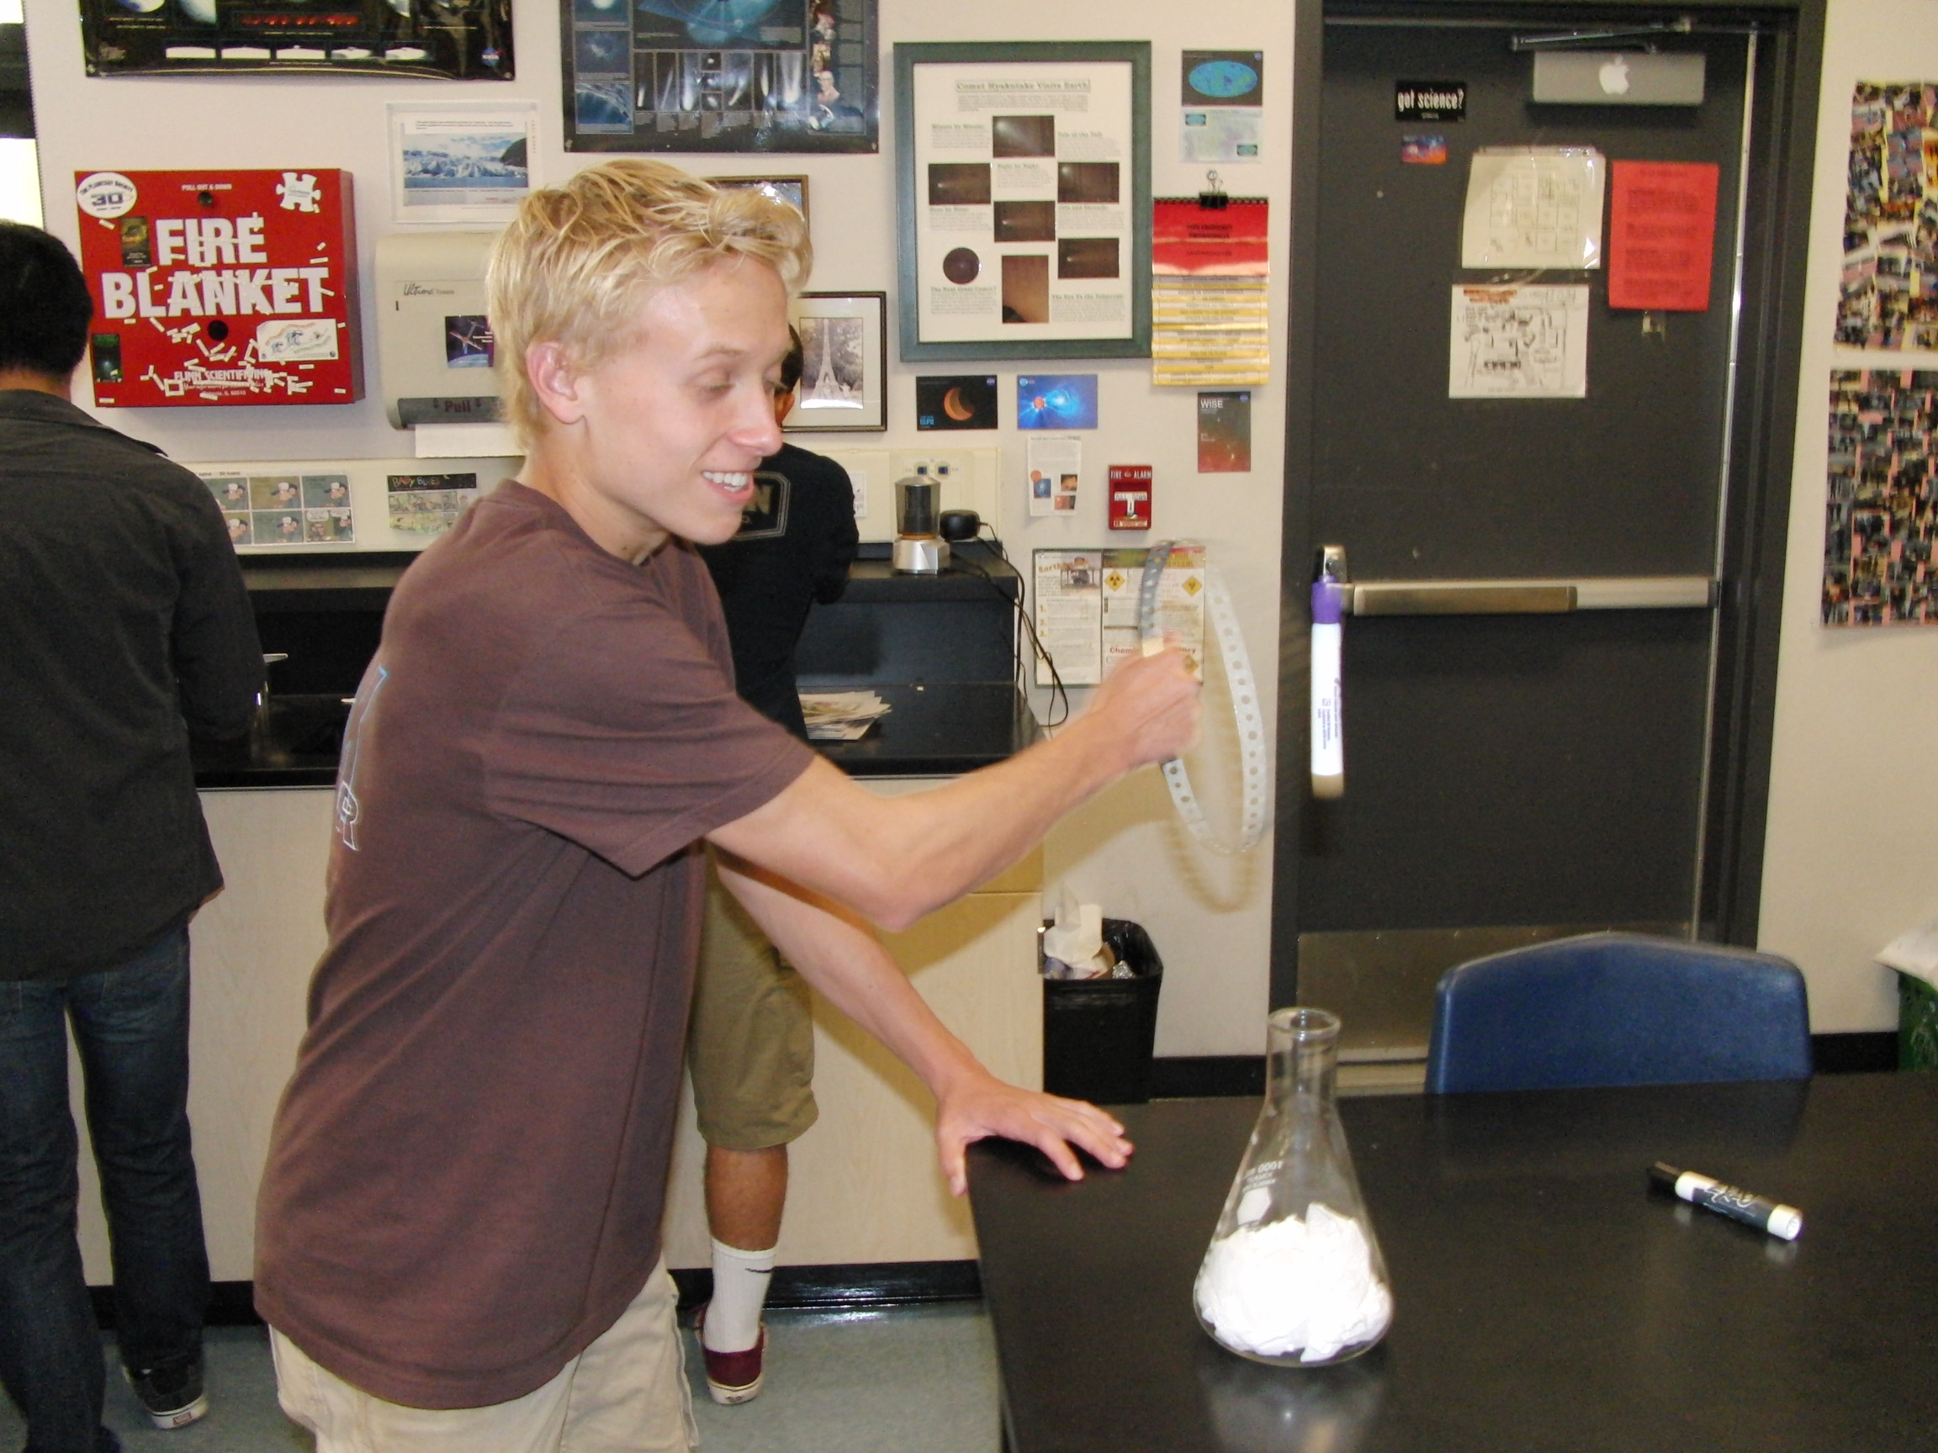
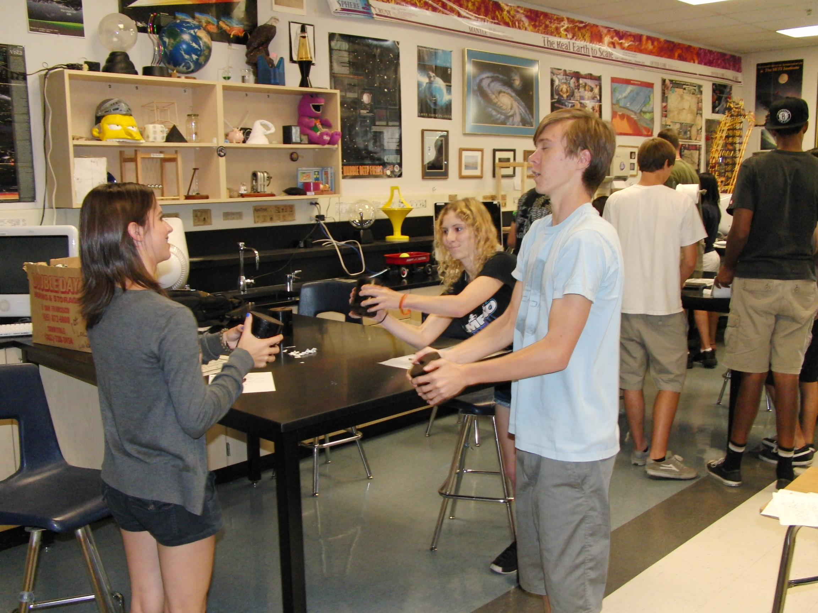
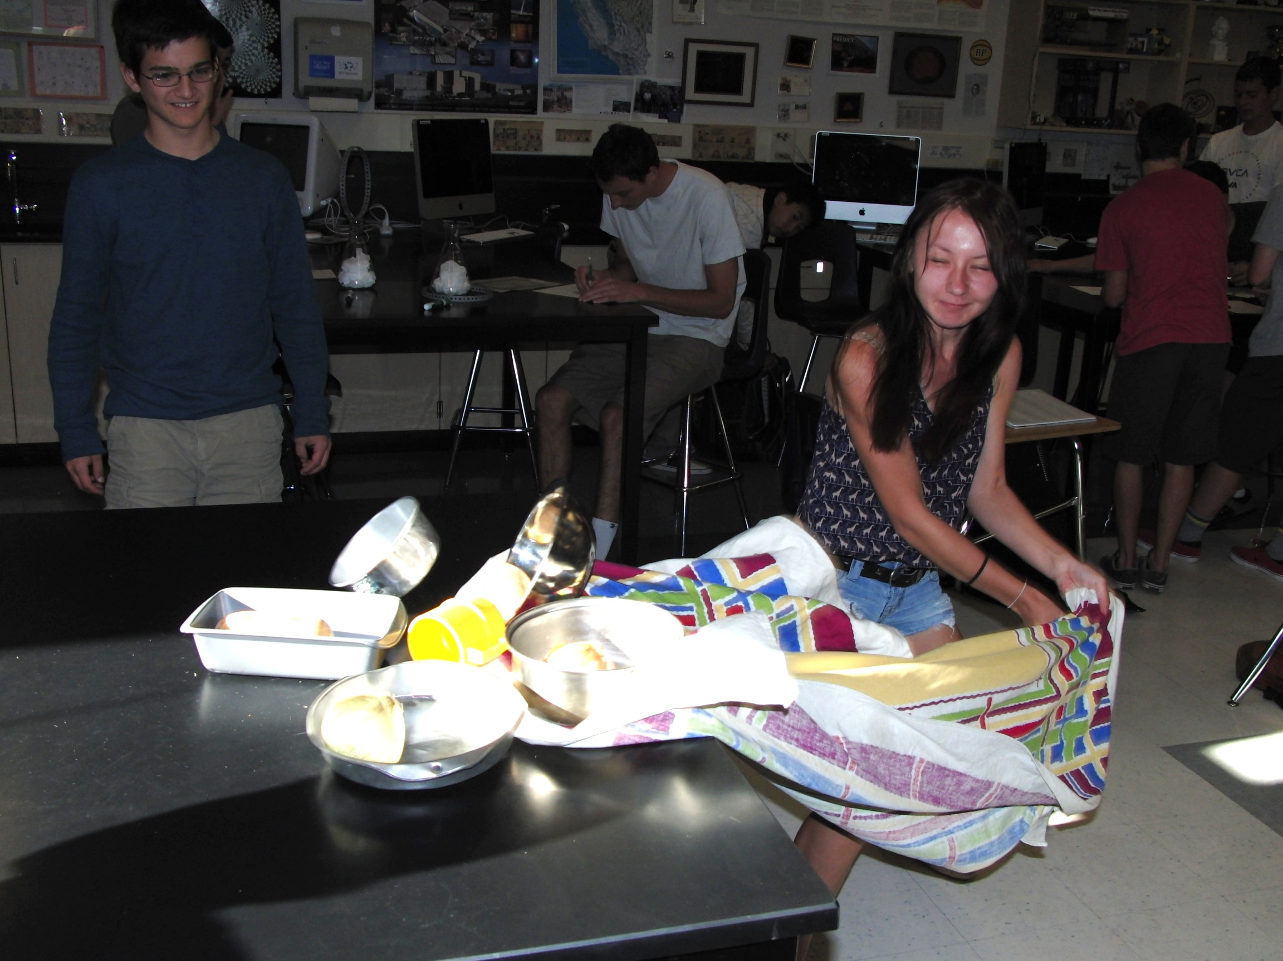
Newton’s First Law
The Mystery of Inertia

Slide 2

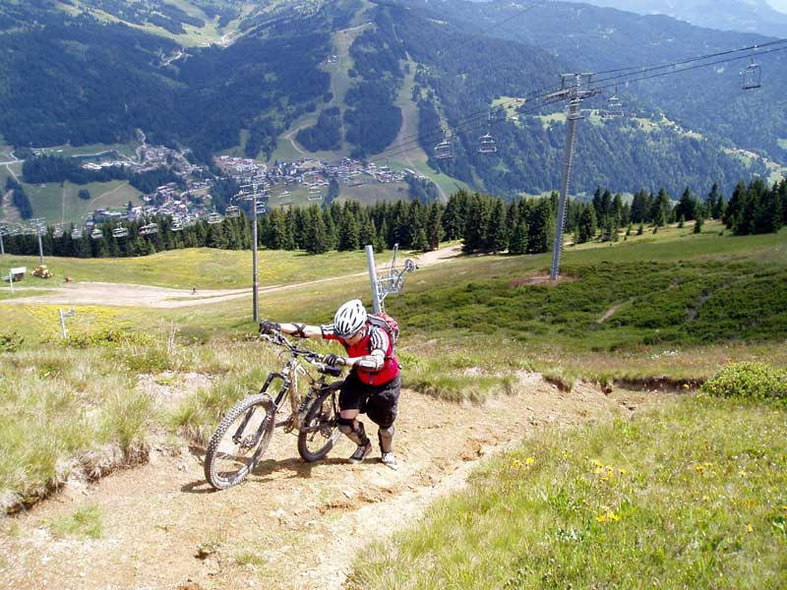
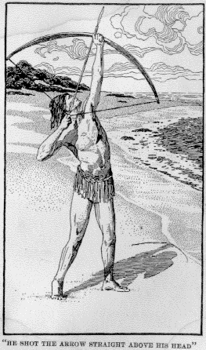

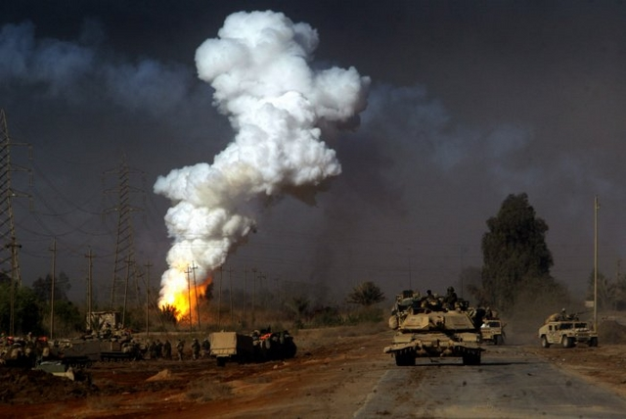
Aristotle’s Laws of Motion
The 4 elements will seek their natural place. They can be temporarily caused to leave their natural place.
Natural Motion
Violent Motion

Slide 3
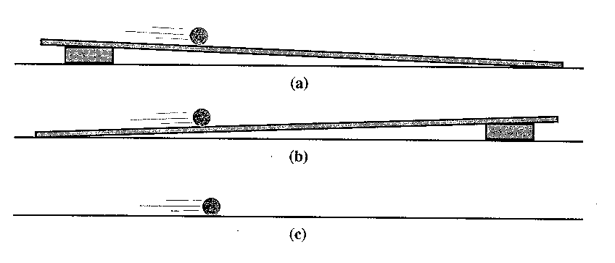
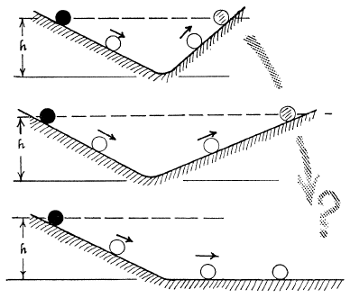
Galileo Worked to Describe Motion
Speeding Up
Slowing Down
Neither?
How does the ball “remember” the original height?
How long would the ball have to roll to reach its original height?

Slide 4
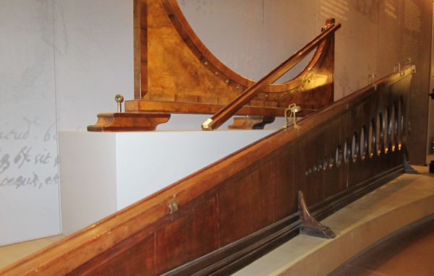
Galileo’s Equipment was Elegant

Slide 5
Galileo used his Ideas about Inertia to Support Copernican Theory
If a force was required to sustain motion, then the rotation and revolution of the Earth would produce absurd results
What would happen if you jumped in the air if both Aristotle and Copernicus were correct?

Slide 6
Newton’s Version of His First Law:
“Every body persists in its state of rest or uniform motion in a straight line unless compelled to change that state by unbalanced forces impressed on it.”
Textbook Version of His First Law:
“If no force acts on a body, we can always find a reference frame in which that body has no acceleration.”

Slide 7
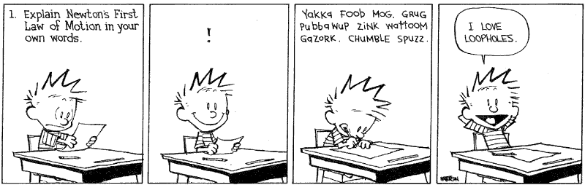
Calvin’s Version of Newton’s First Law:

Slide 8
Mass Vs Weight
Inertia is the resistance of an object to changes in its current state of motion
Mass is a measure of the resistance of an object to changes in its current state of motion, measured in kilograms
Weight is a measure of how hard gravity pulls on an object, measured in newtons
Mass does not depend on the location of the object, weight does
Weight = Mass x Gravitational Field Strength = mg
Weight of 1 kilogram = 1 kg × 9.8 N/kg = 9.8 N

Slide 9
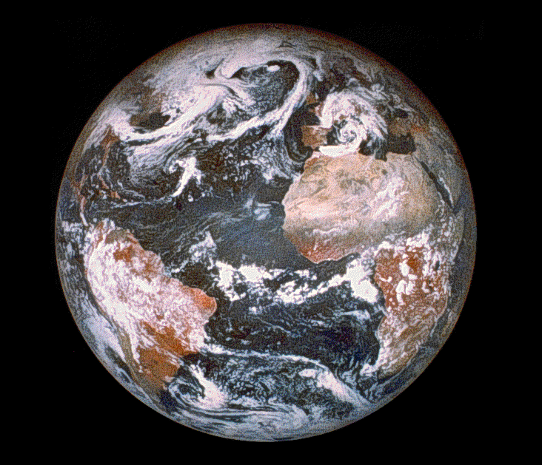
Mass is not the Same Thing as Weight, Why Should I Care?

Slide 10
Mass is not the Same Thing as Weight, Why Should I Care?
Cargo is 0.6% less in weight at the Equator, that’s 600 missing tons!

Slide 11
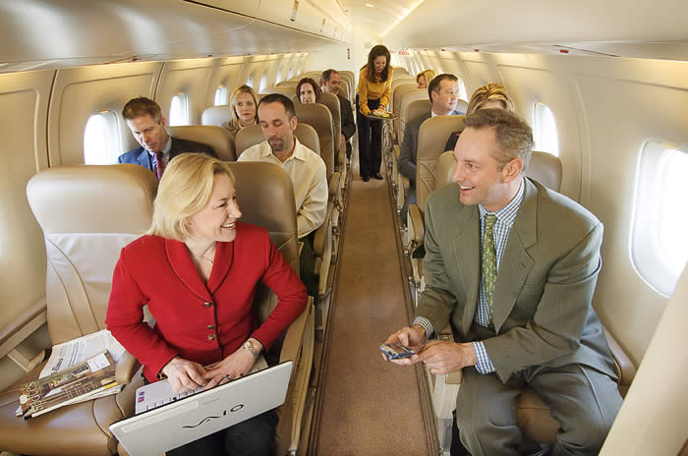
You drop your cell phone in the aisle of a jet plane and it lands on the floor directly below where you dropped it. From this you can conclude:
A. The jet is at rest on the runway
B. The jet is cruising at a constant velocity of 550mph
C. The jet is speeding up
D. The jet is slowing down
E. None of the above

Slide 12
How can you tell if you are at rest or in uniform motion?
A. Use a radar detector
B. Drop a ball and see where it lands
C. You can feel the motion
D. If you don’t see anything moving, you are at rest
E. It is impossible to tell

Slide 13
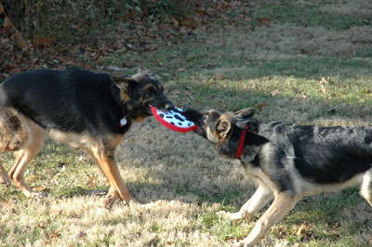
An object is pulled by equal forces in opposite directions. Which of the following could be true?
A. It is at rest
B. It is accelerating
C. It is in uniform motion
D. Either A or C
E. Either A or B

Slide 14
You are driving down the freeway with the cruise control set at 65 mph. Which of the following is true?
A. The forces pushing the car forward are the greatest
B. The forces pushing the car backwards are the greatest
C. The forward forces equal the backward forces
D. There is no backward force
E. E is never the right answer

Slide 15
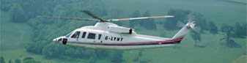
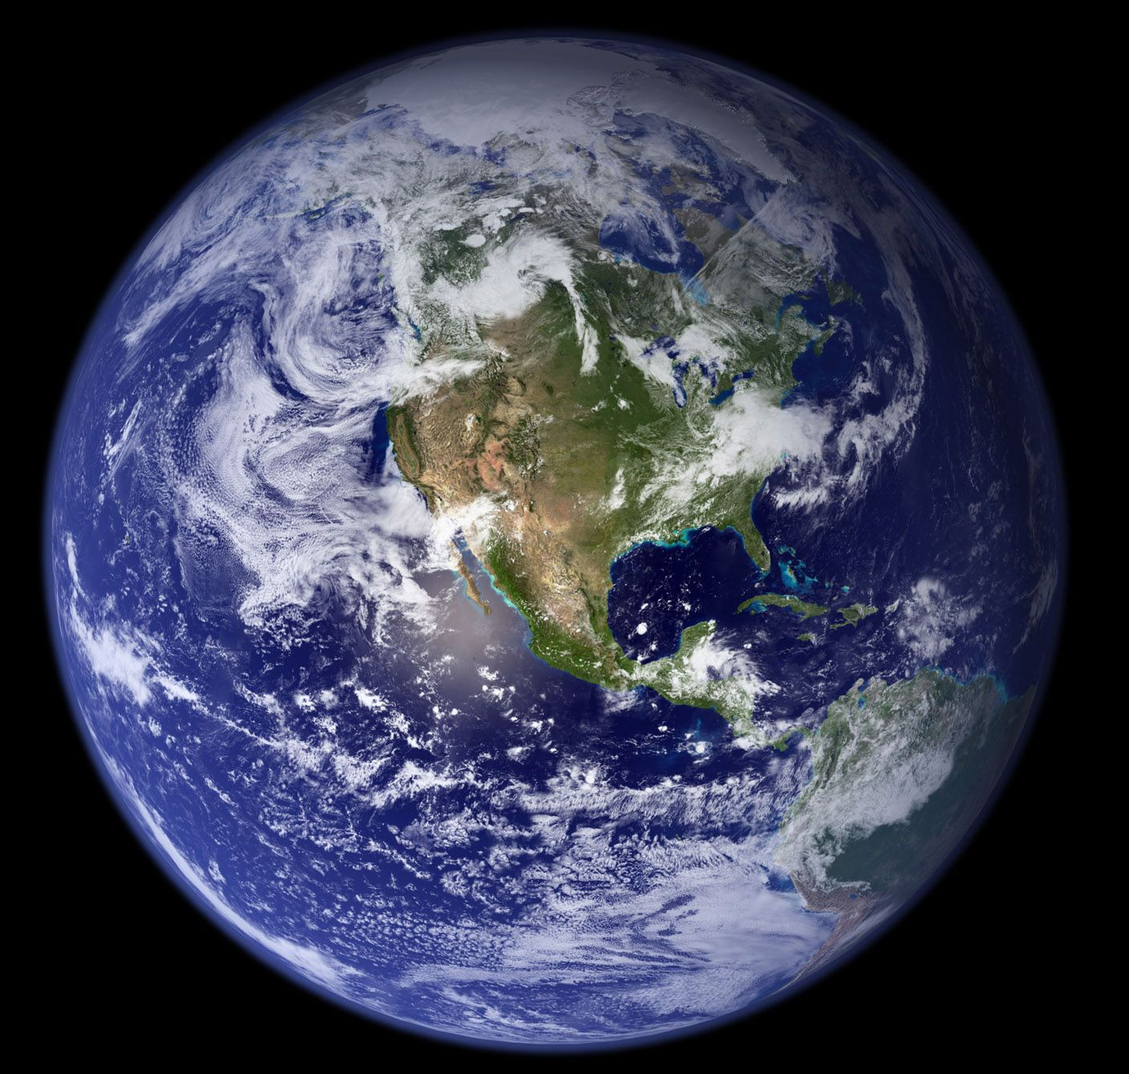
Great Transportation Idea?

Slide 16
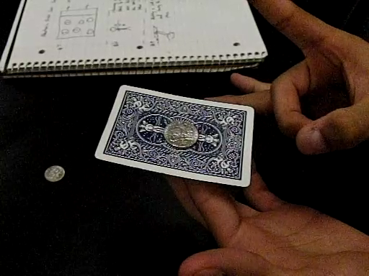
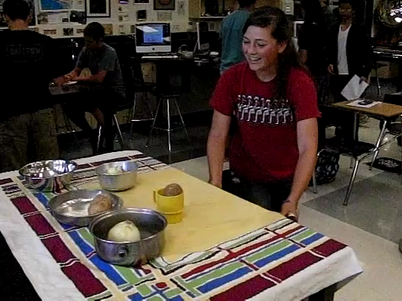
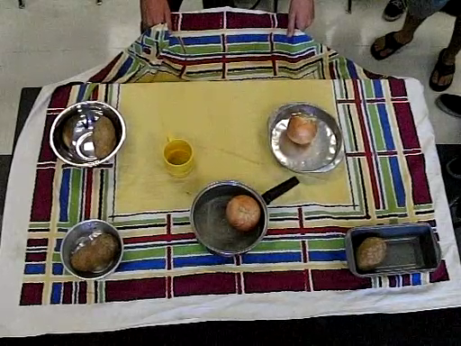
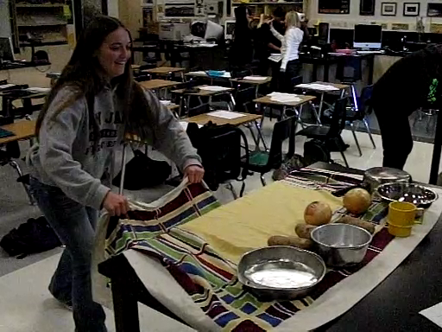
What is Going On With These Stations?

Slide 17
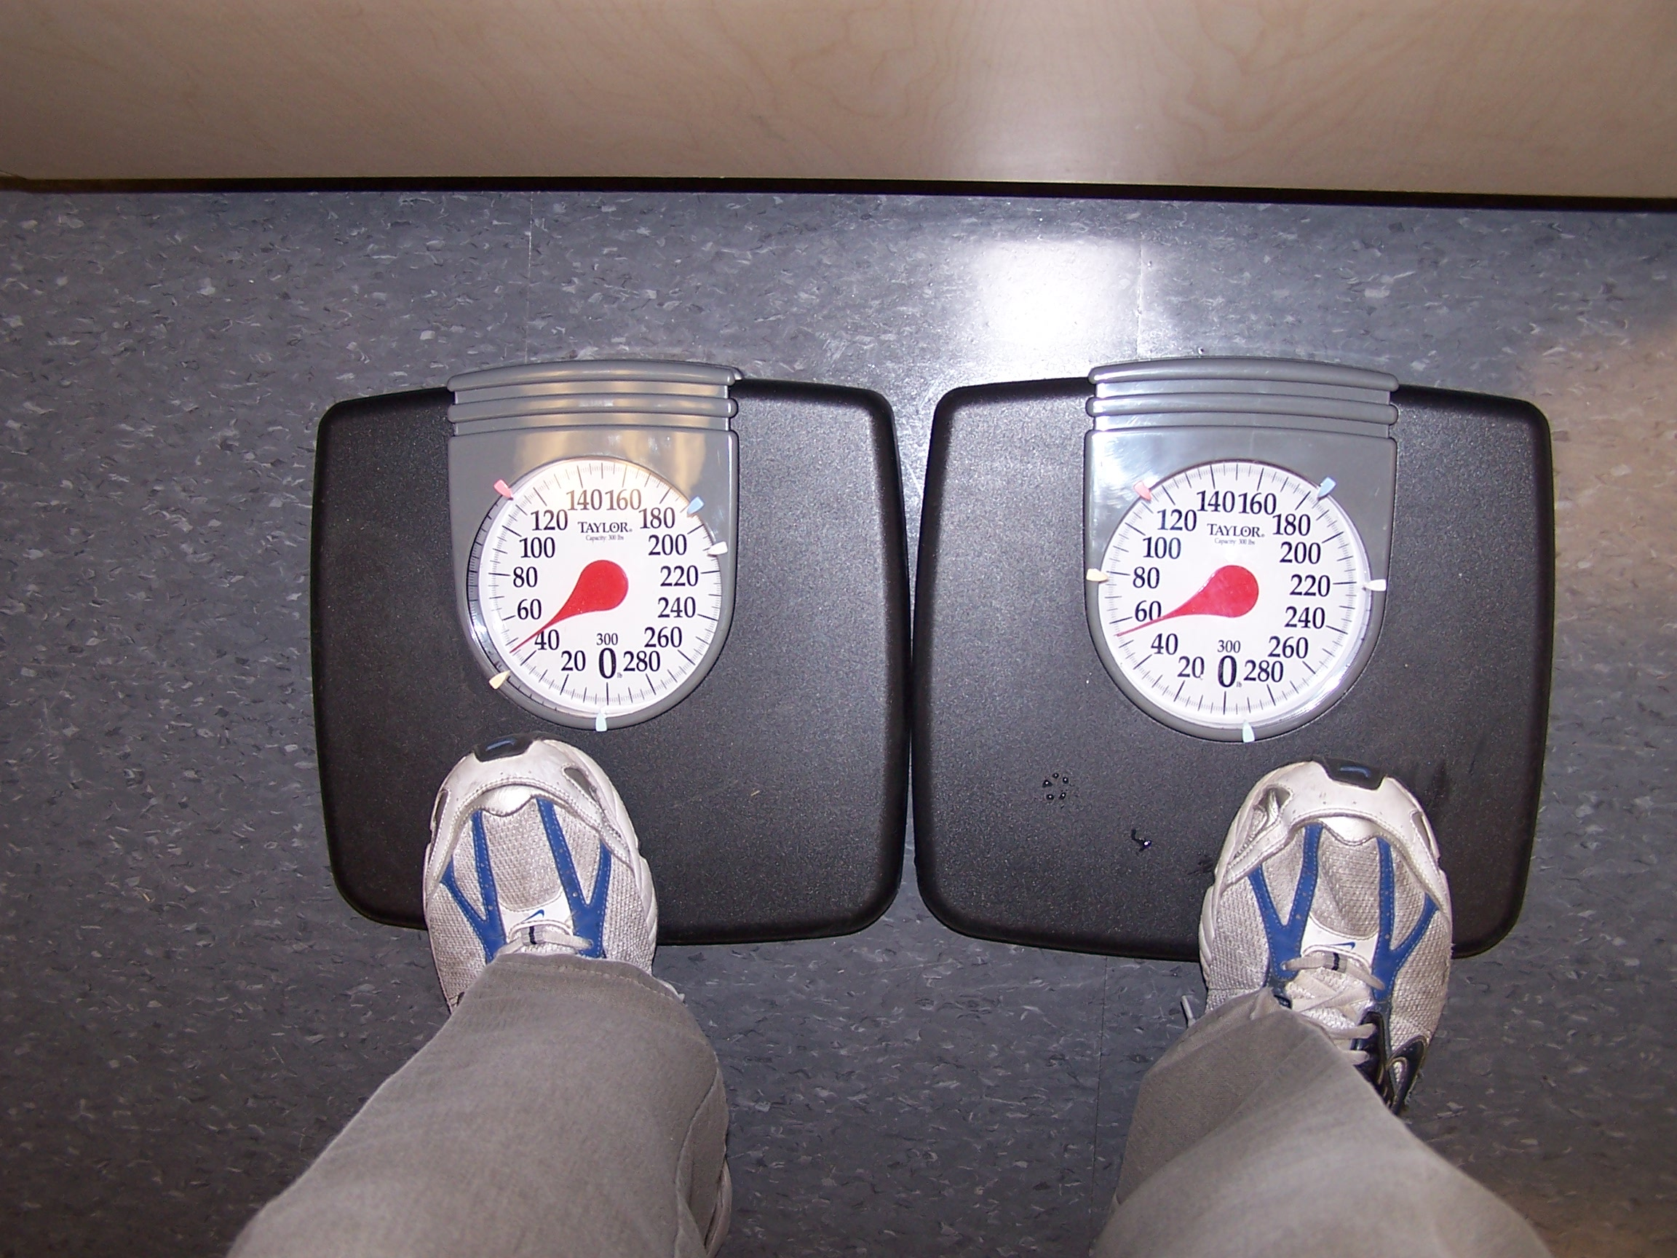
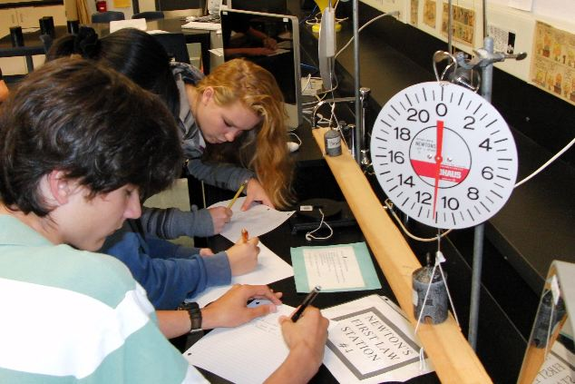
What is Going On With These Stations?

Slide 18

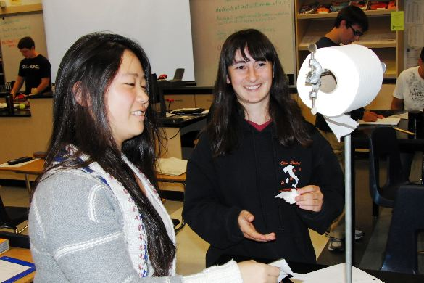
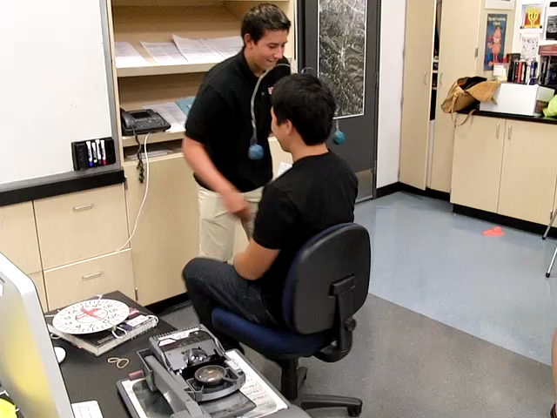
What is Going On With These Stations?

Slide 19
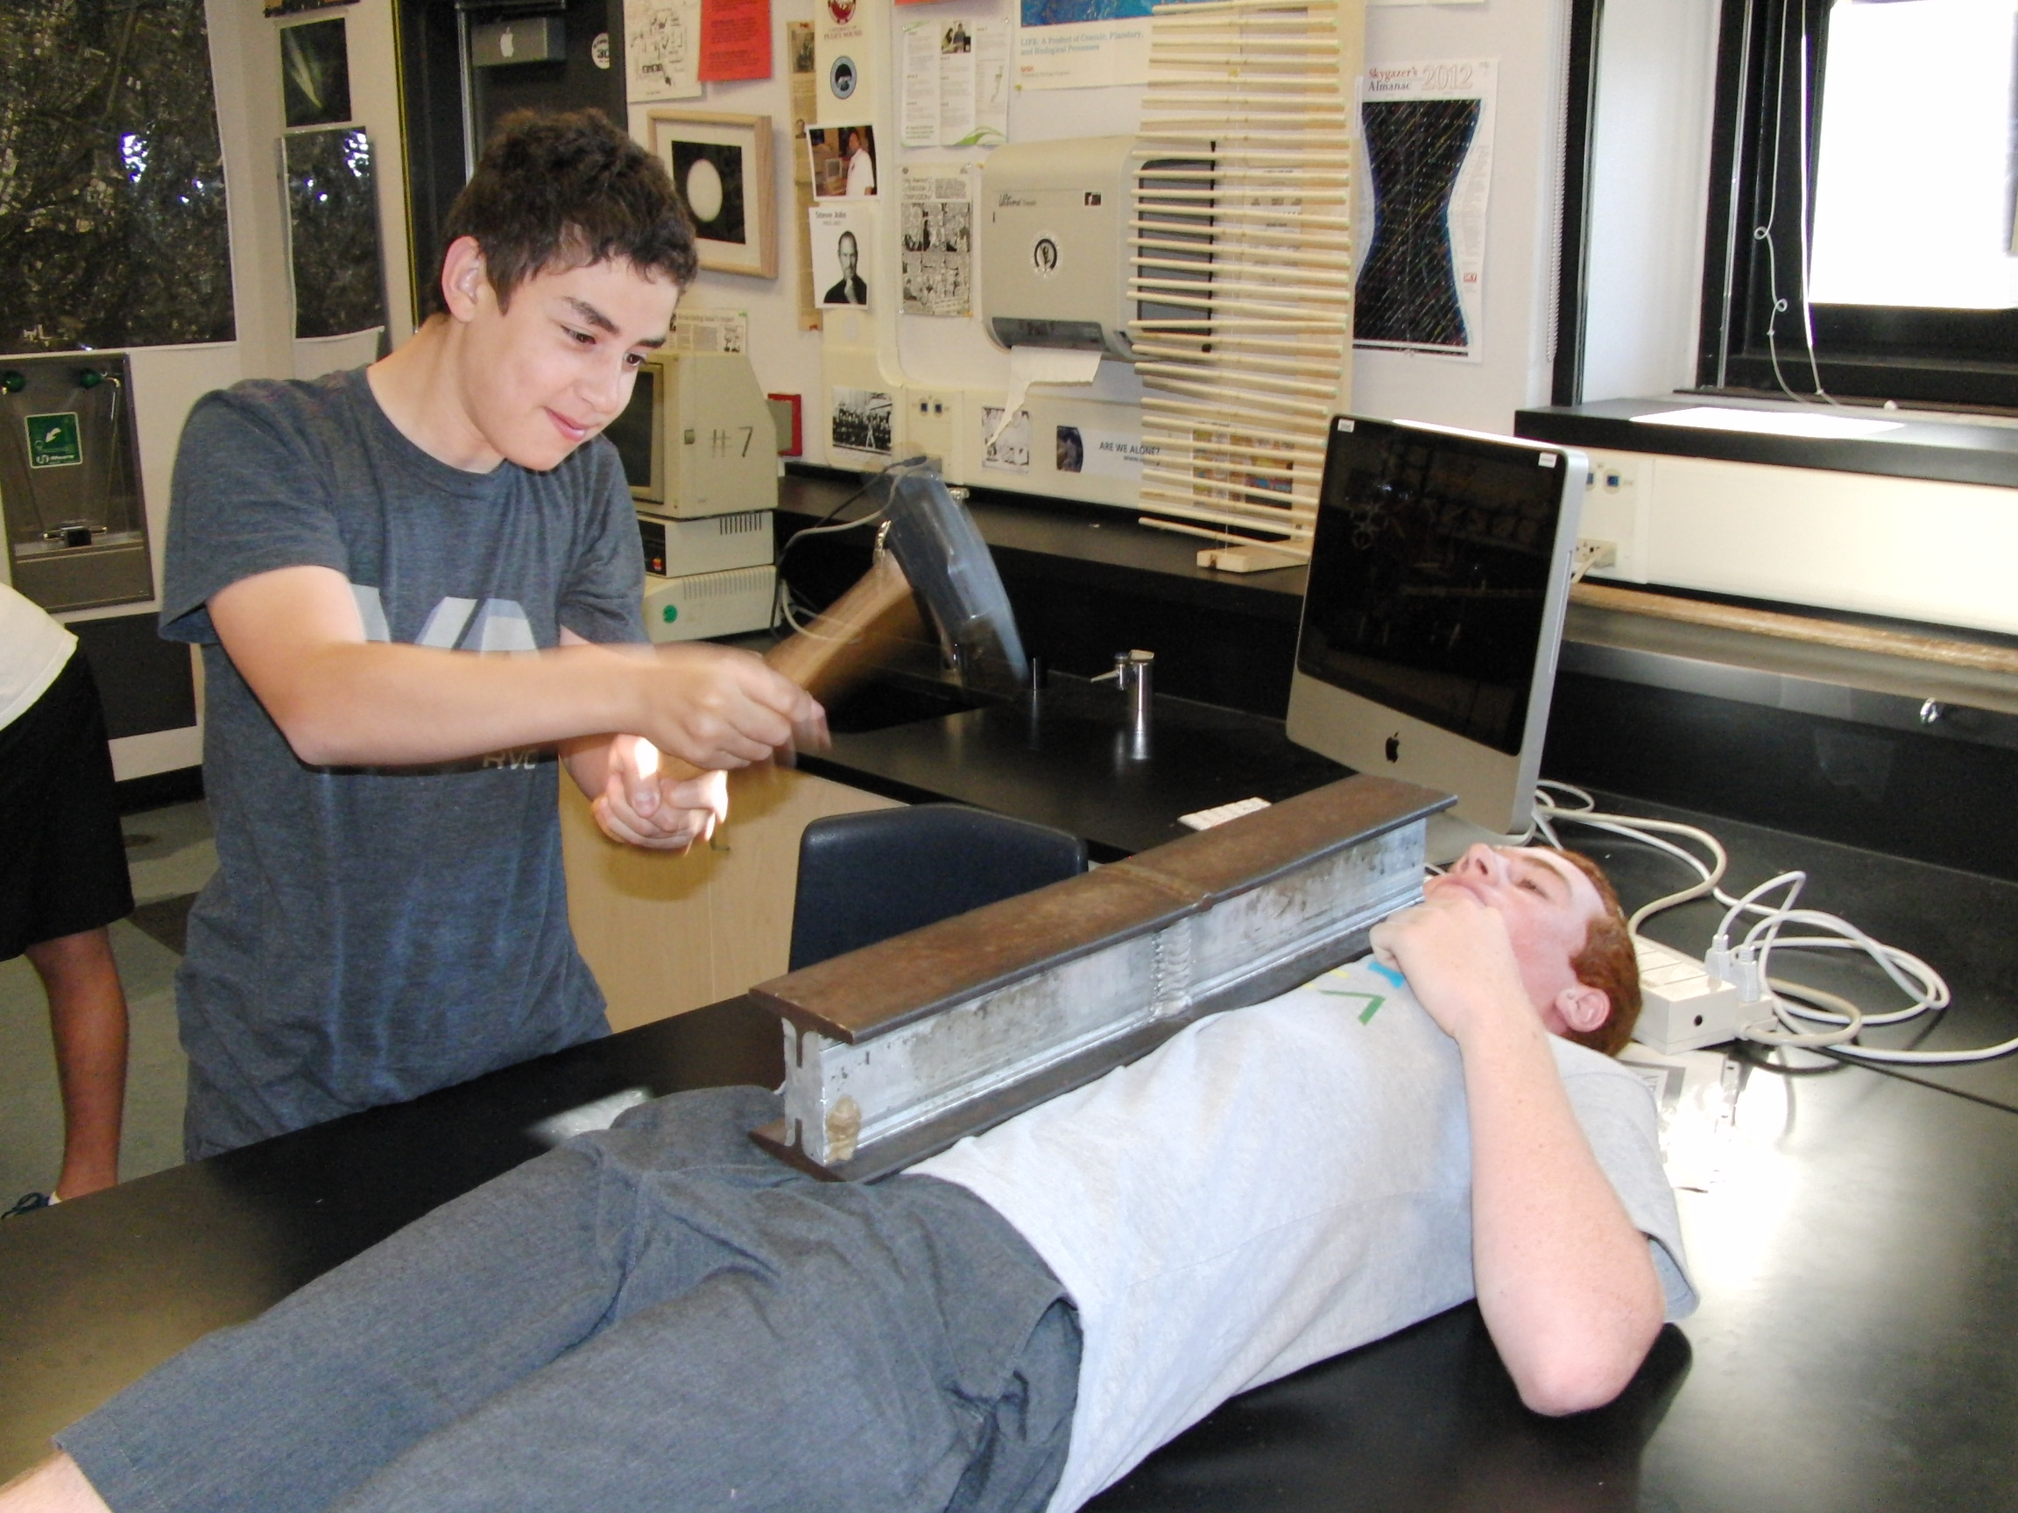
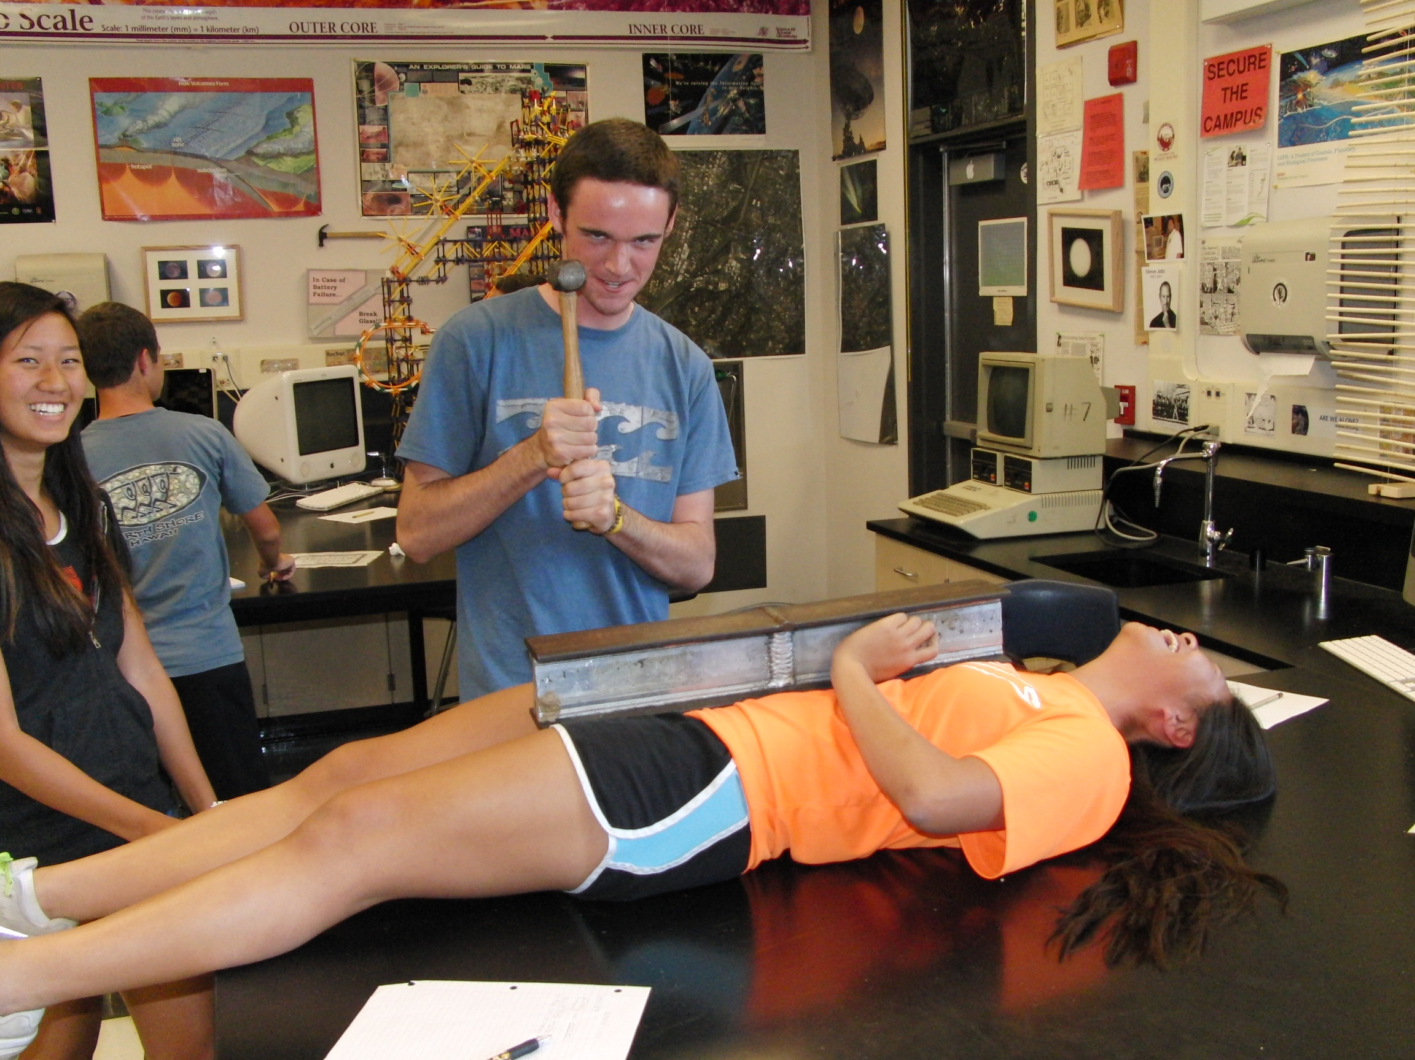
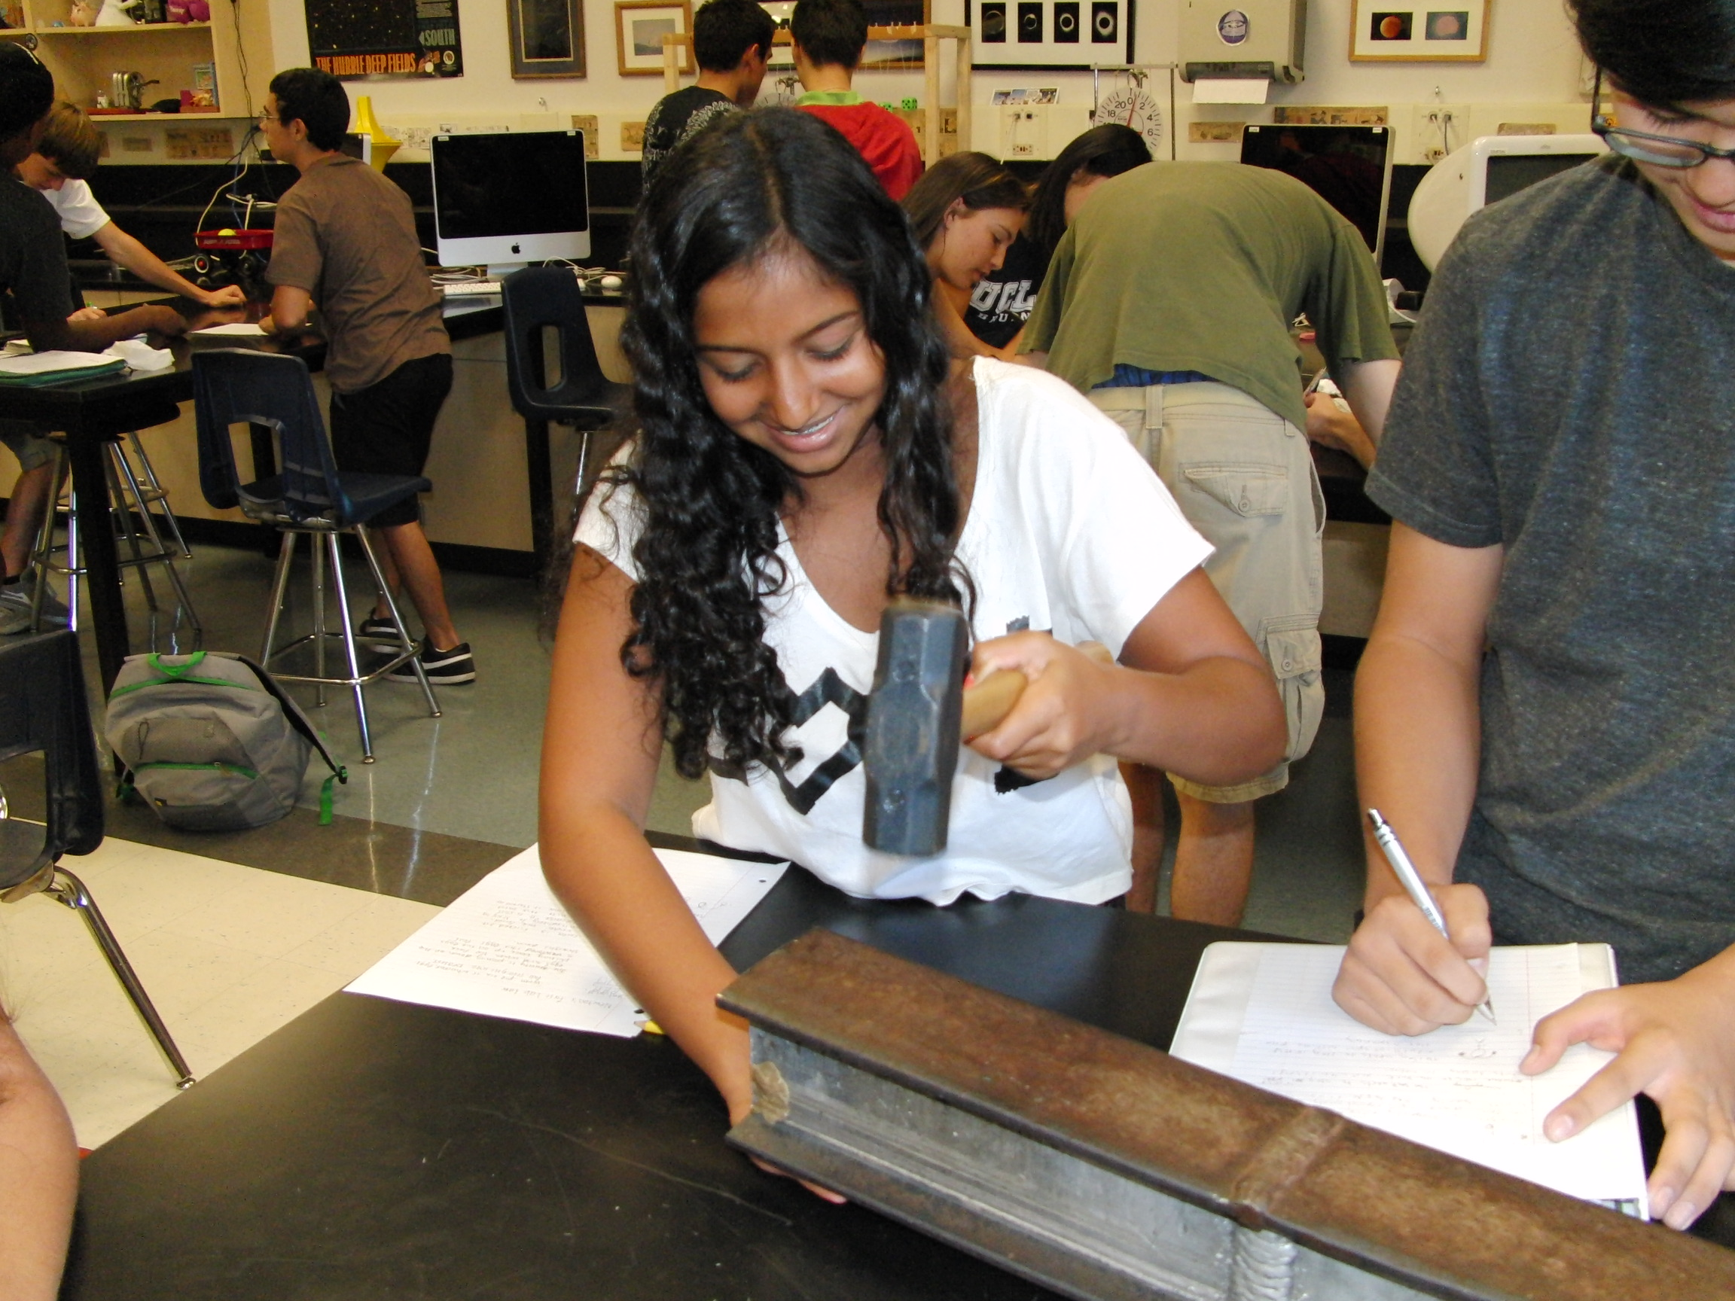
What is Going On With This Station?

Slide 20
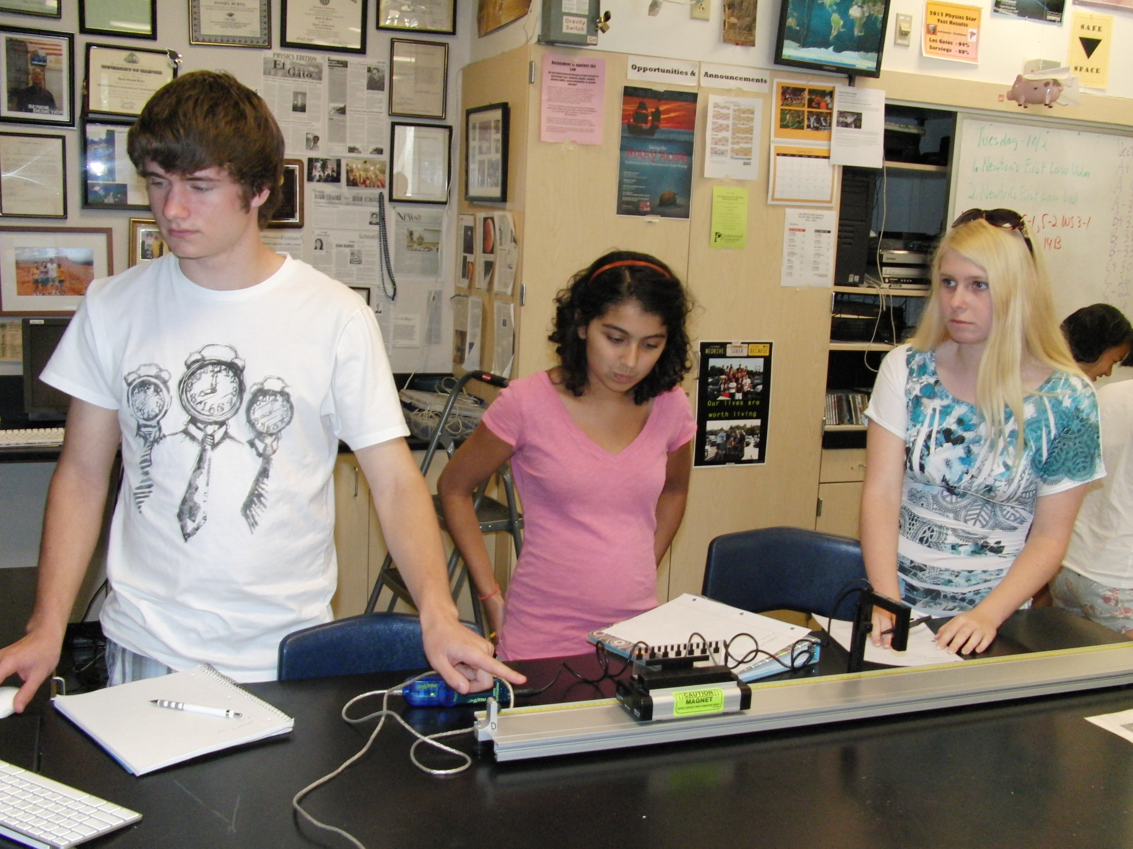
What is Going On With This Station?

Slide 21
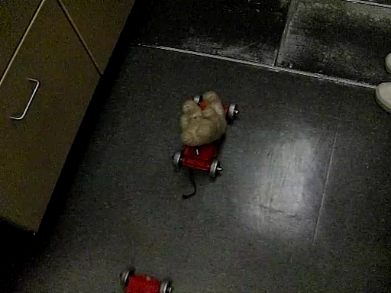
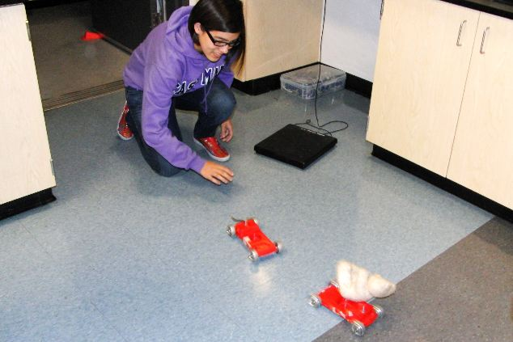
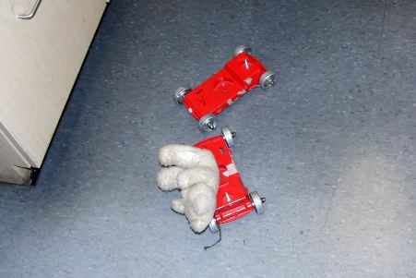
What is Going On With This Station?

Slide 22
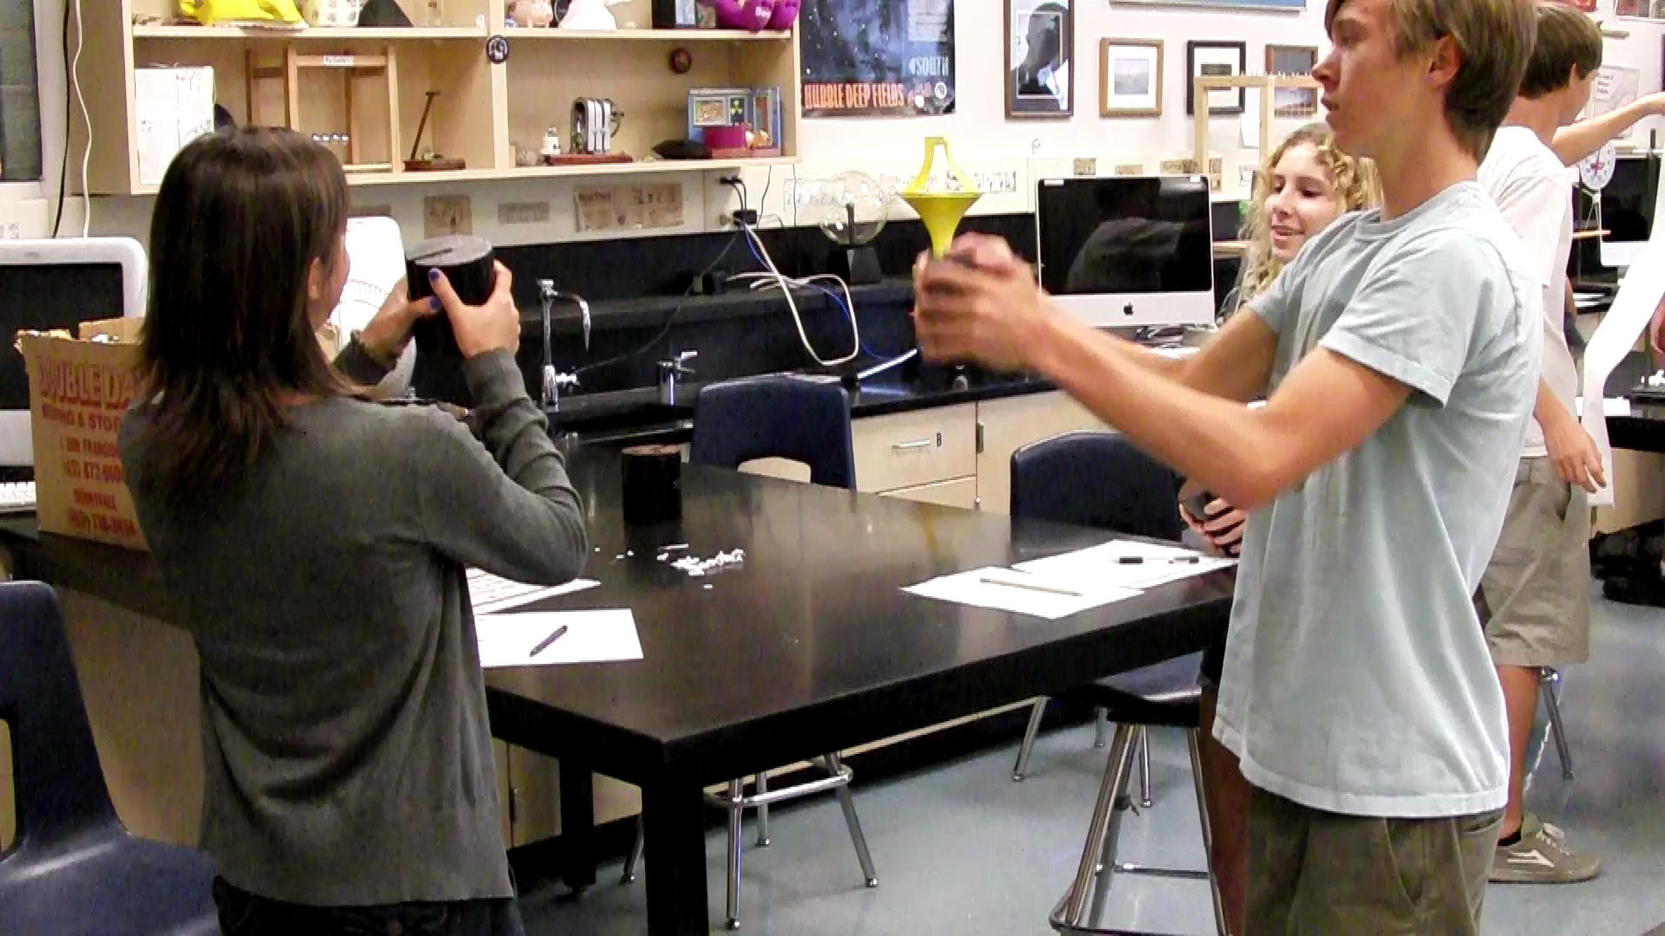
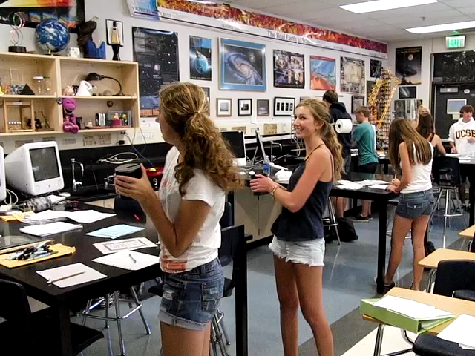
What is Going On With This Station?

Slide 23
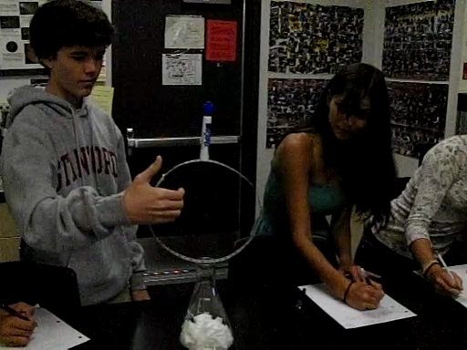
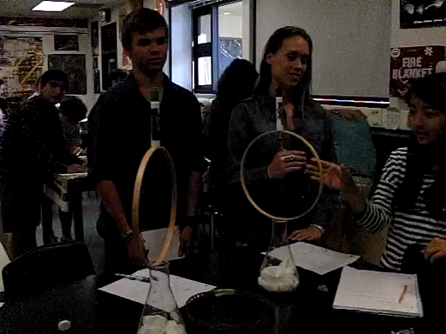

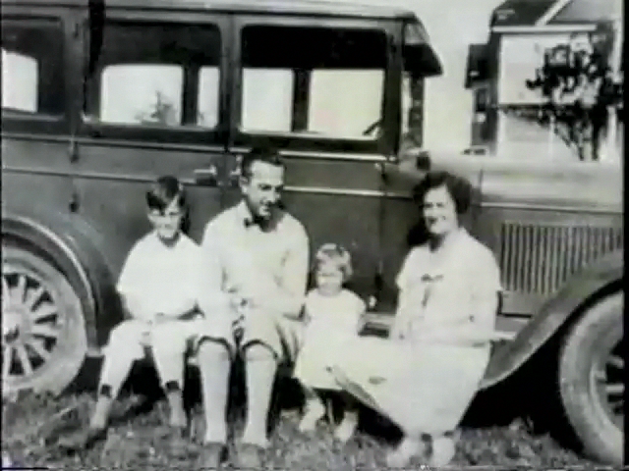
What is Going On With These Stations?

Slide 24
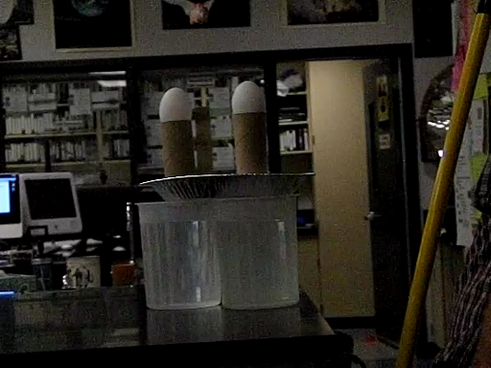
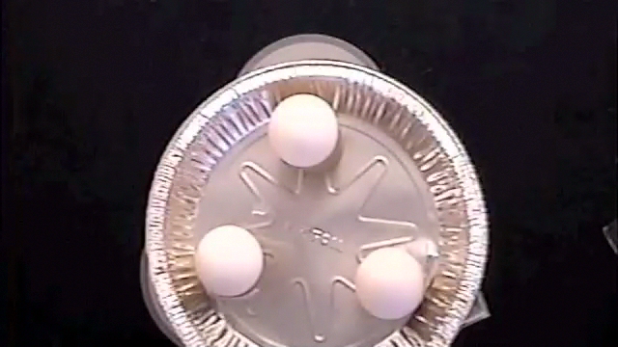
What is Going On With This Station?

Slide 25
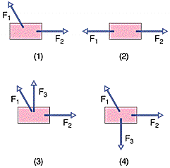
The figure below shows overhead views of four situations
in which forces act on a block that lies on a frictionless floor.
If the force magnitudes are chosen properly, in which situations
is it possible that the block is stationary?
A. 1 only
B. 1 and 3
C. 2 only
D. 2 and 4
If the force magnitudes are chosen properly, in which situations
is it possible that the block is moving with a constant velocity?
A. 4 only
B. 1 and 2
C. 2 and 4
D. 2 only

